Slide 1

Decoding the neural representations
of social concepts
Daniel Alcalá López, David Soto
June 4, 2019

Slide 2
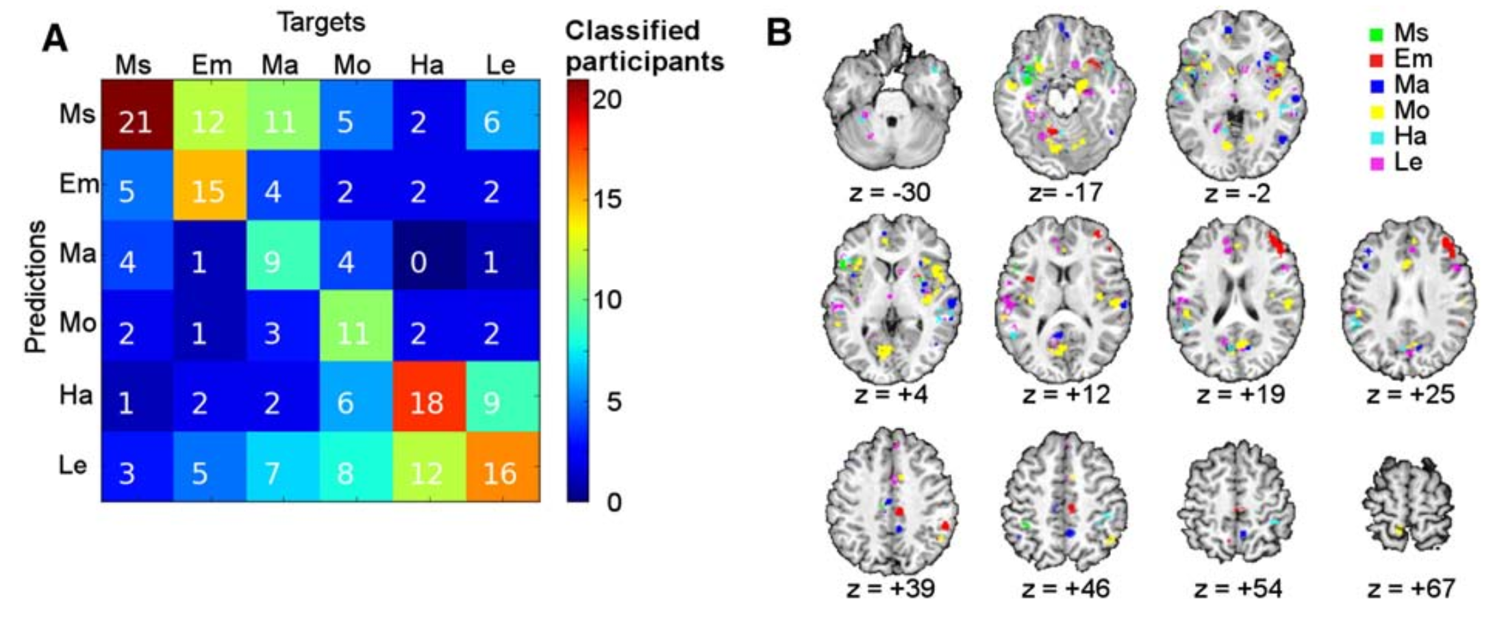

Previous work assessed the neural representations of concrete concepts
(e.g. animals or tools)
Few studies using abstract concepts (e.g. mathematical or mental)
Ghio et al. 2016 Neuroimage

Slide 3
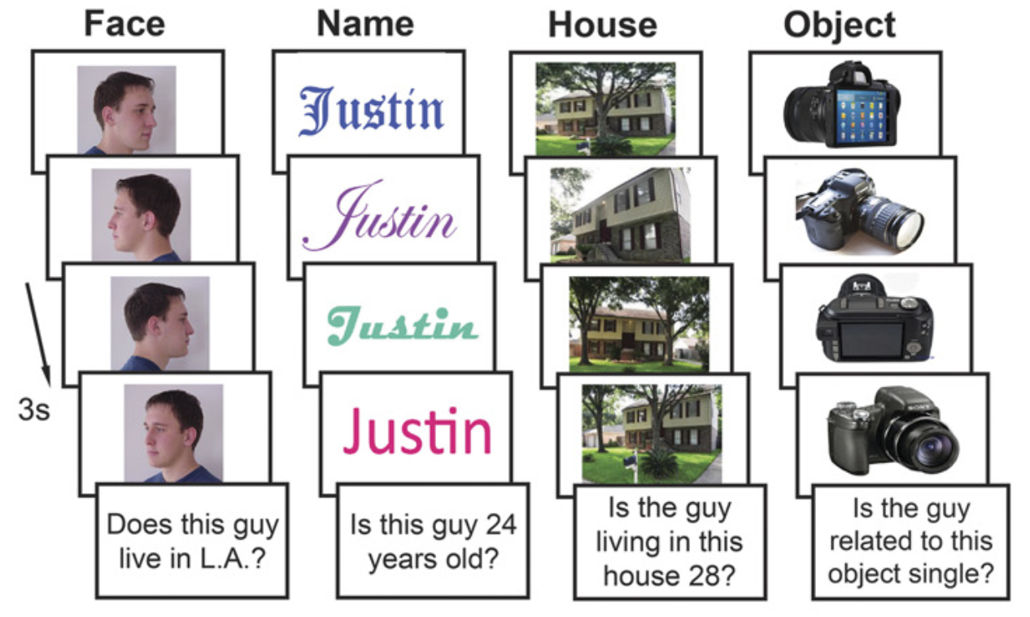
Faces, voices, body gestures,
biological movements…
Social information
concepts?
Wang et al. 2017 PNAS

Slide 4
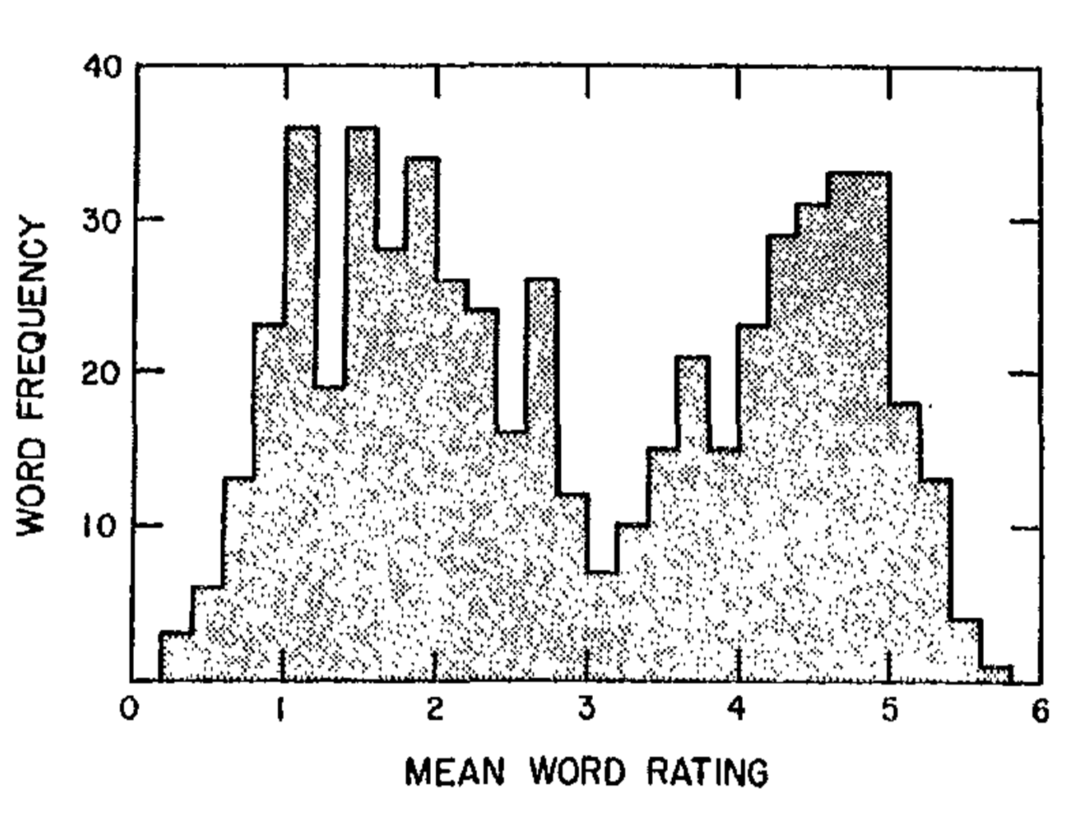
To study how social abstract concepts are represented in the brain
particularly, with regard to the two fundamental dimensions of interest:
+ affect
+ likableness
Anderson 1968 J Pers Soc Psychol

Slide 5
How did we measure this?

Slide 6
Participants:
listen to short definitions of social concepts
think about the concept (e.g. attribute the referred
interpersonal attitudes, beliefs, intentions, or emotions
to a family member, acquaintance, public figure, etc.)
fixation
*
delay
“Sabe razonar, resolver problemas
y comprender ideas complejas”
definition
250 ms
500 ms
think
jitter
3 s
*
3 s
8 s

Slide 7
nonaffective concepts
affective concepts
Sincero/a
Comprensivo/a
Leal
Inteligente
Generoso/a
Ingenioso/a
Cooperativo/a
Indulgente
Concienzudo/a
Sincere
Understanding
Loyal
Intelligent
Unselfish
Clever
Helpful
Forgiving
Conscientious
high likableness
Empático/a
Afable
Bondadoso/a
Animado/a
Cariñoso/a
Entusiasta
Agradecido/a
Sensible
Compasivo/a
Empathetic
Good-natured
Kind
Cheerful
Warm-hearted
Enthusiastic
Grateful
Sensible
Sympathetic
Vago/a
Irresponsable
Prejuicioso/a
Aburrido/a
Hostil
Egoísta
Maleducado/a
Codicioso/a
Farsante
Lazy
Irresponsible
Prejudiced
Boring
Hostile
Selfish
Rude
Greedy
Phony
Envidioso/a
Exaltado/a
Neurótico/a
Resentido/a
Pesimista
Despiadado
Condescendiente
Insensible
Cruel
Envious
Hot-tempered
Neurotic
Resentful
Gloomy
Unforgiving
Snobbish
Insensitive
Cruel
low likableness

Slide 8
removal of non-brain tissue using FSL’s BET
volume realignment using MCFLIRT
gaussian kernel (FWHM = 3mm) for spatial smoothing
ICA-based automatic removal of motion artefacts
temporal filtering (high-pass; cutoff = 60s)
coalignment of each session to a reference volume (1st session)

Slide 9
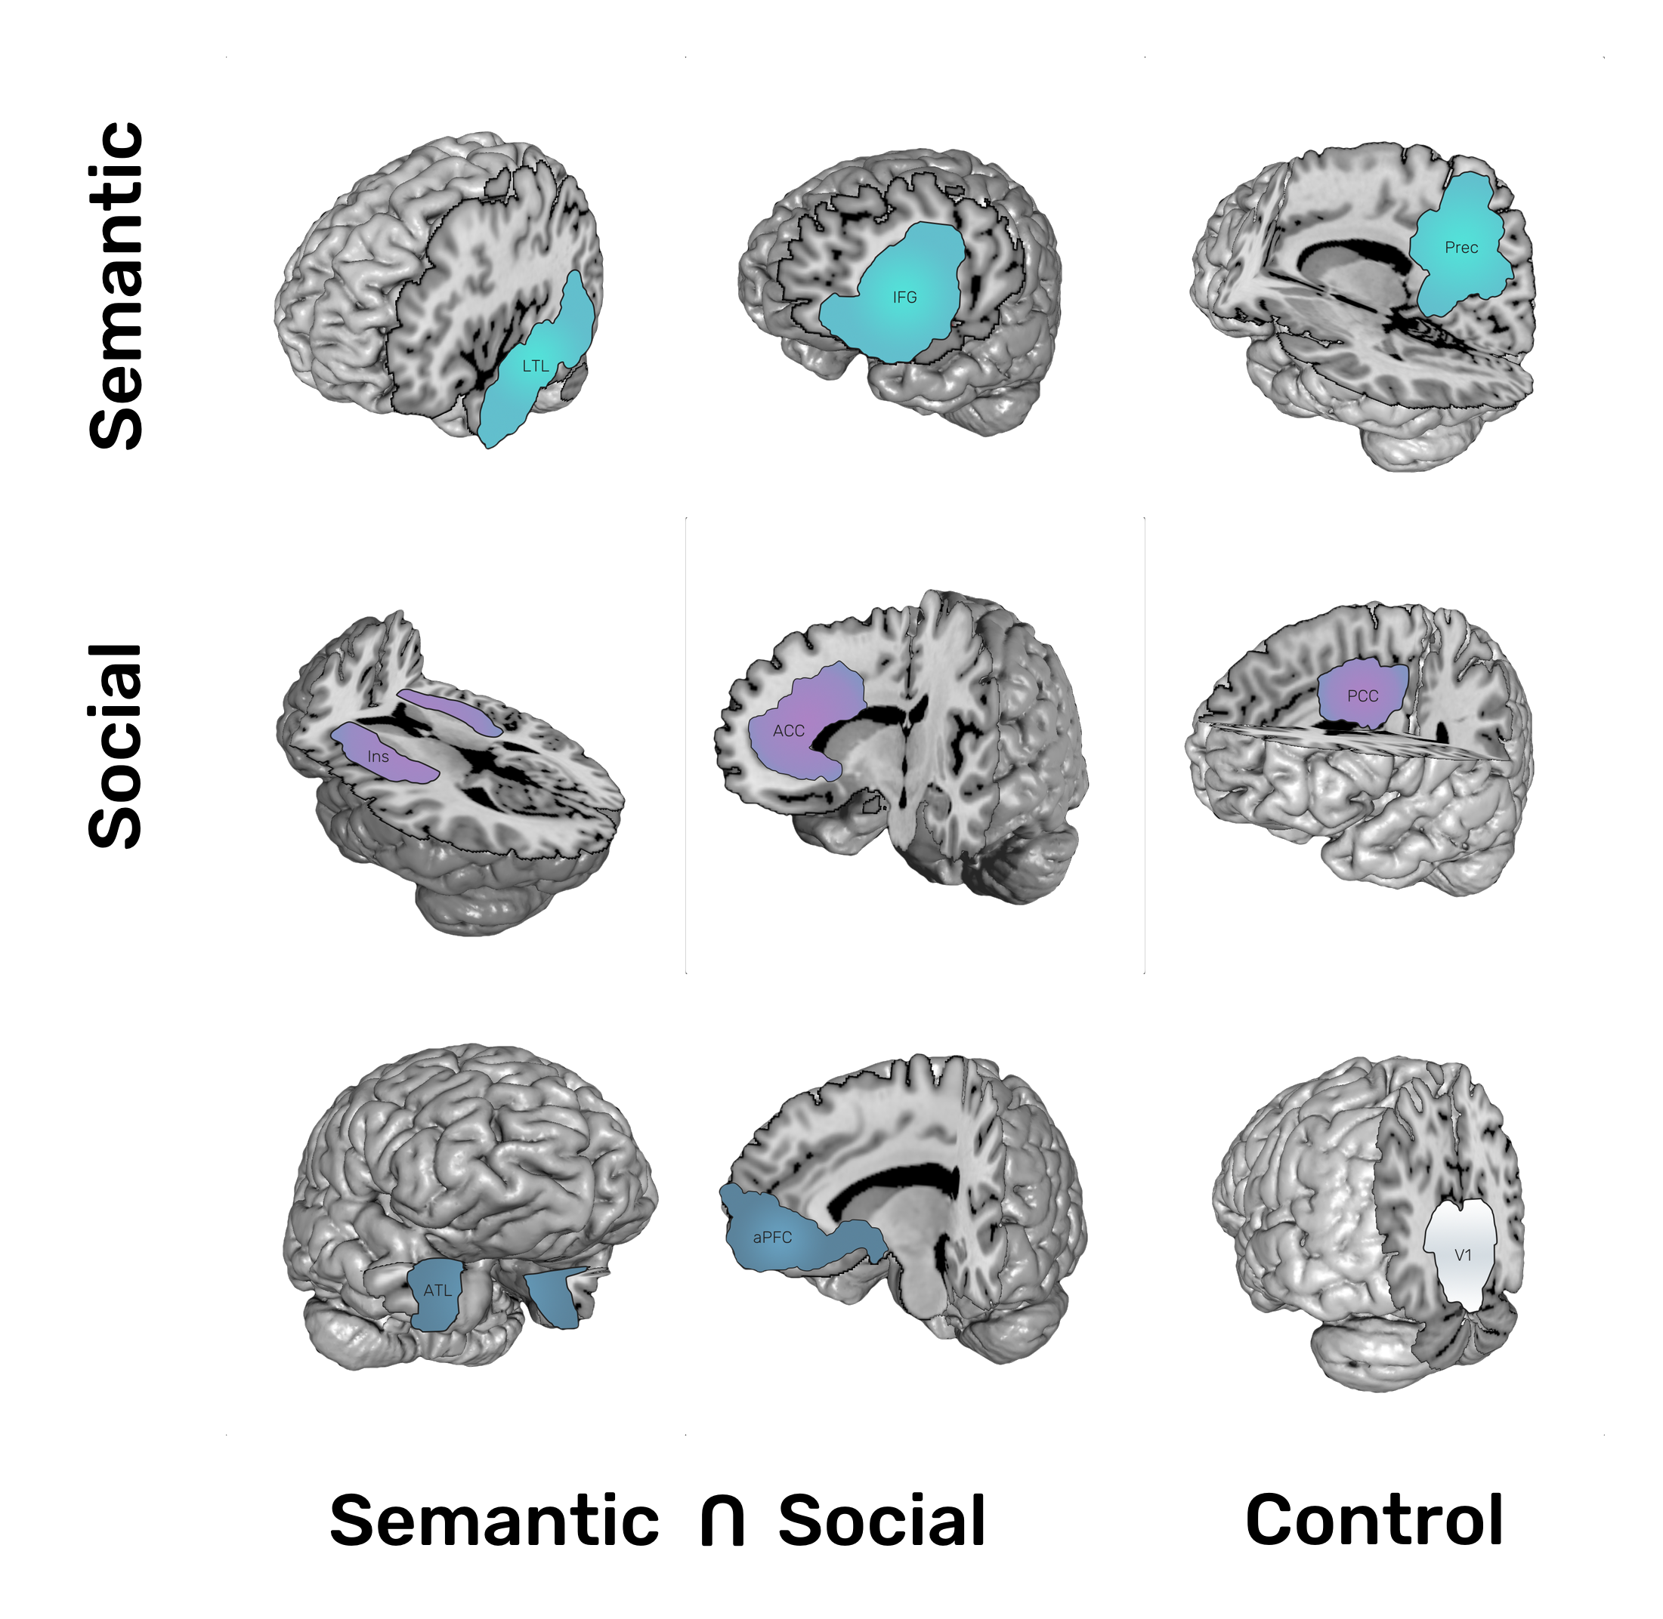
8 ROIs (+1) based on previous studies:
+ semantic (abstract vs. concrete concepts)
+ mental-state attribution
+ intersection semantic & social
+ control region

Slide 10
Are subjective ratings reliable?

Slide 11
ID | Concept | Rating | Time
sub-001 | Aburrido/a | 20 | pre
sub-001 | Aburrido/a | 10 | post
sub-001 | Afable | 65 | pre
sub-001 | Afable | 70 | post
… | … | … | …
sub-030 | Sincero/a | 50 | pre
sub-030 | Sincero/a | 50 | post
sub-030 | Vago/a | 10 | pre
sub-030 | Vago/a | 0 | post
ICC_{affect} = 0’47 [0,36-0,60]
ICC_{likableness} = 0’93 [0,89-0,96]
Notes:
The intraclass correlation (ICC) assesses the reliability of ratings by comparing the variability of different ratings of the same subject to the total variation across all ratings and subjects.
“””
There are three types of variability:
- var(β): variability due to differences in the subjects (i.e. the concepts).
- var(ε): variability due to differences in the evaluations of the subjects by the judges.
- var(α): variability due to differences in the rating scale used by the judges.
“””
Statistical analysis
Repeatability analysis was performed on the subjective ratings of a group of 30 participants randomly chosen and assessed at two different time points (before and after the scanning session). The intraclass correlation coefficient (ICC) was used for the analysis. A two-way mixed-effect model based on single ratings and absolute agreement assessed the test-retest repeatability. Mean estimations along with 95% confidence intervals (CI) were reported for each ICC.
Results
The ICC for test-retest reliability was fair for the affect condition ICC(affect): 0’47 [0,36-0,60] and excellent for the likableness condition ICC(likableness): 0’93 [0’89-0’96].
MSR= mean square for rows; MSE=mean square for error; MSC= mean square for columns; n=number of subjects; k= number of raters/measurements.

Slide 12
How did participants rate our concepts?

Slide 13
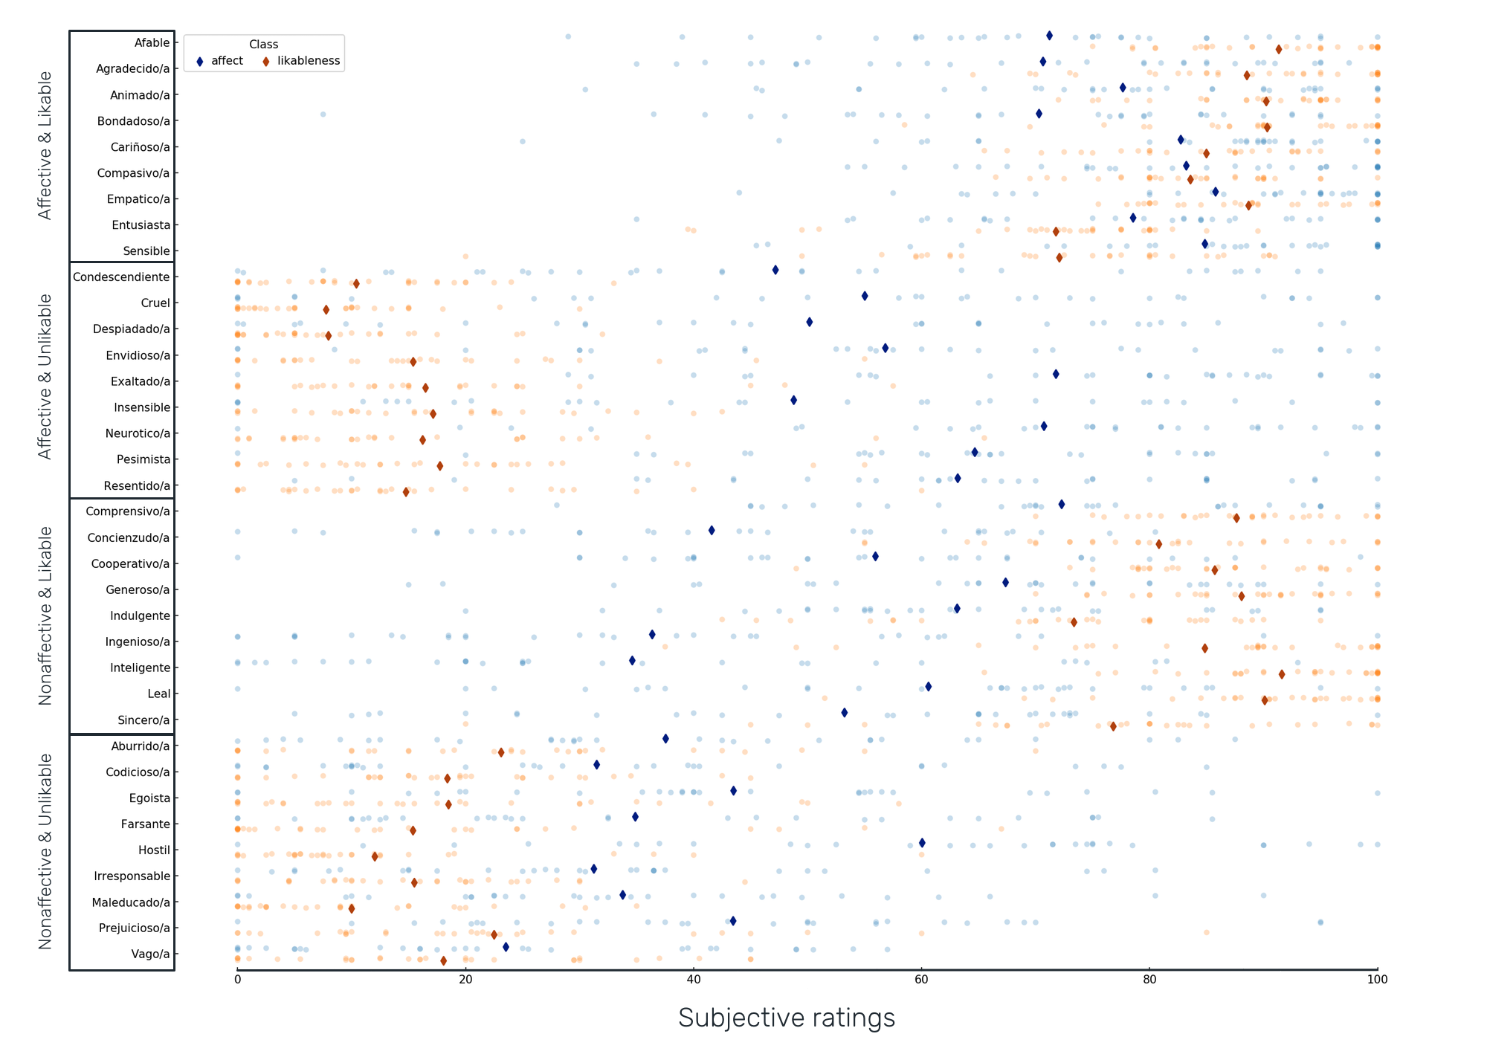
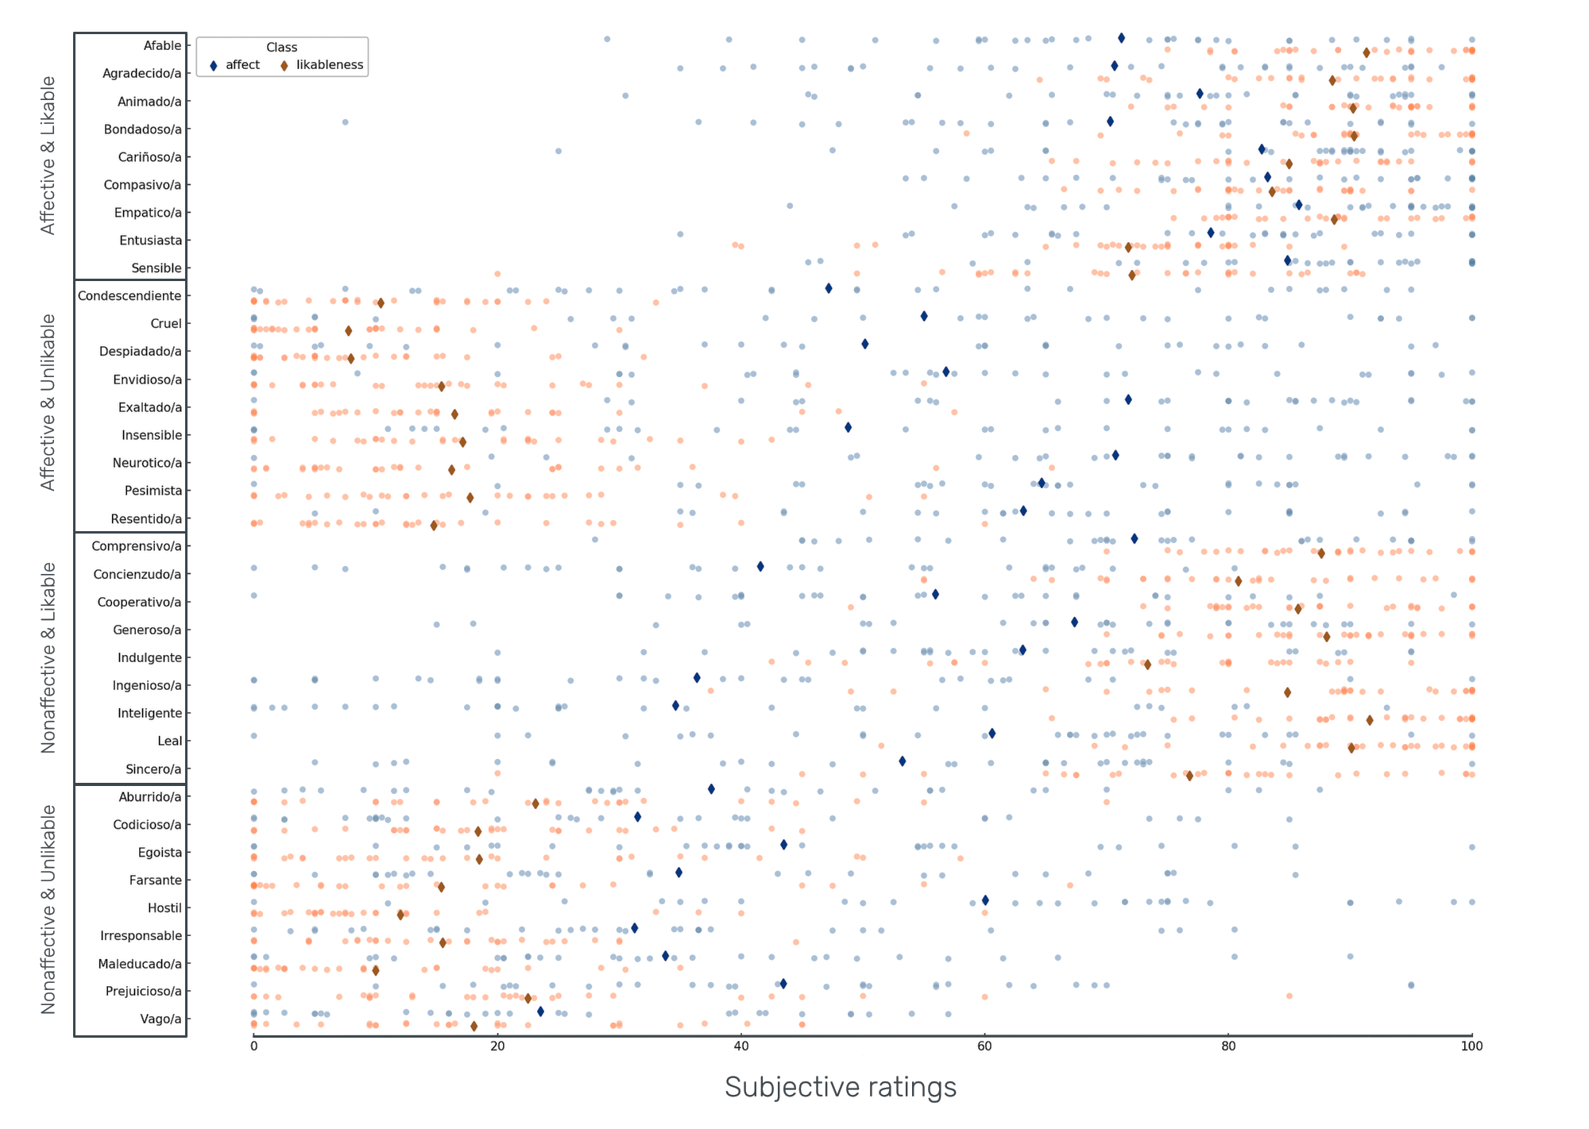

Slide 14
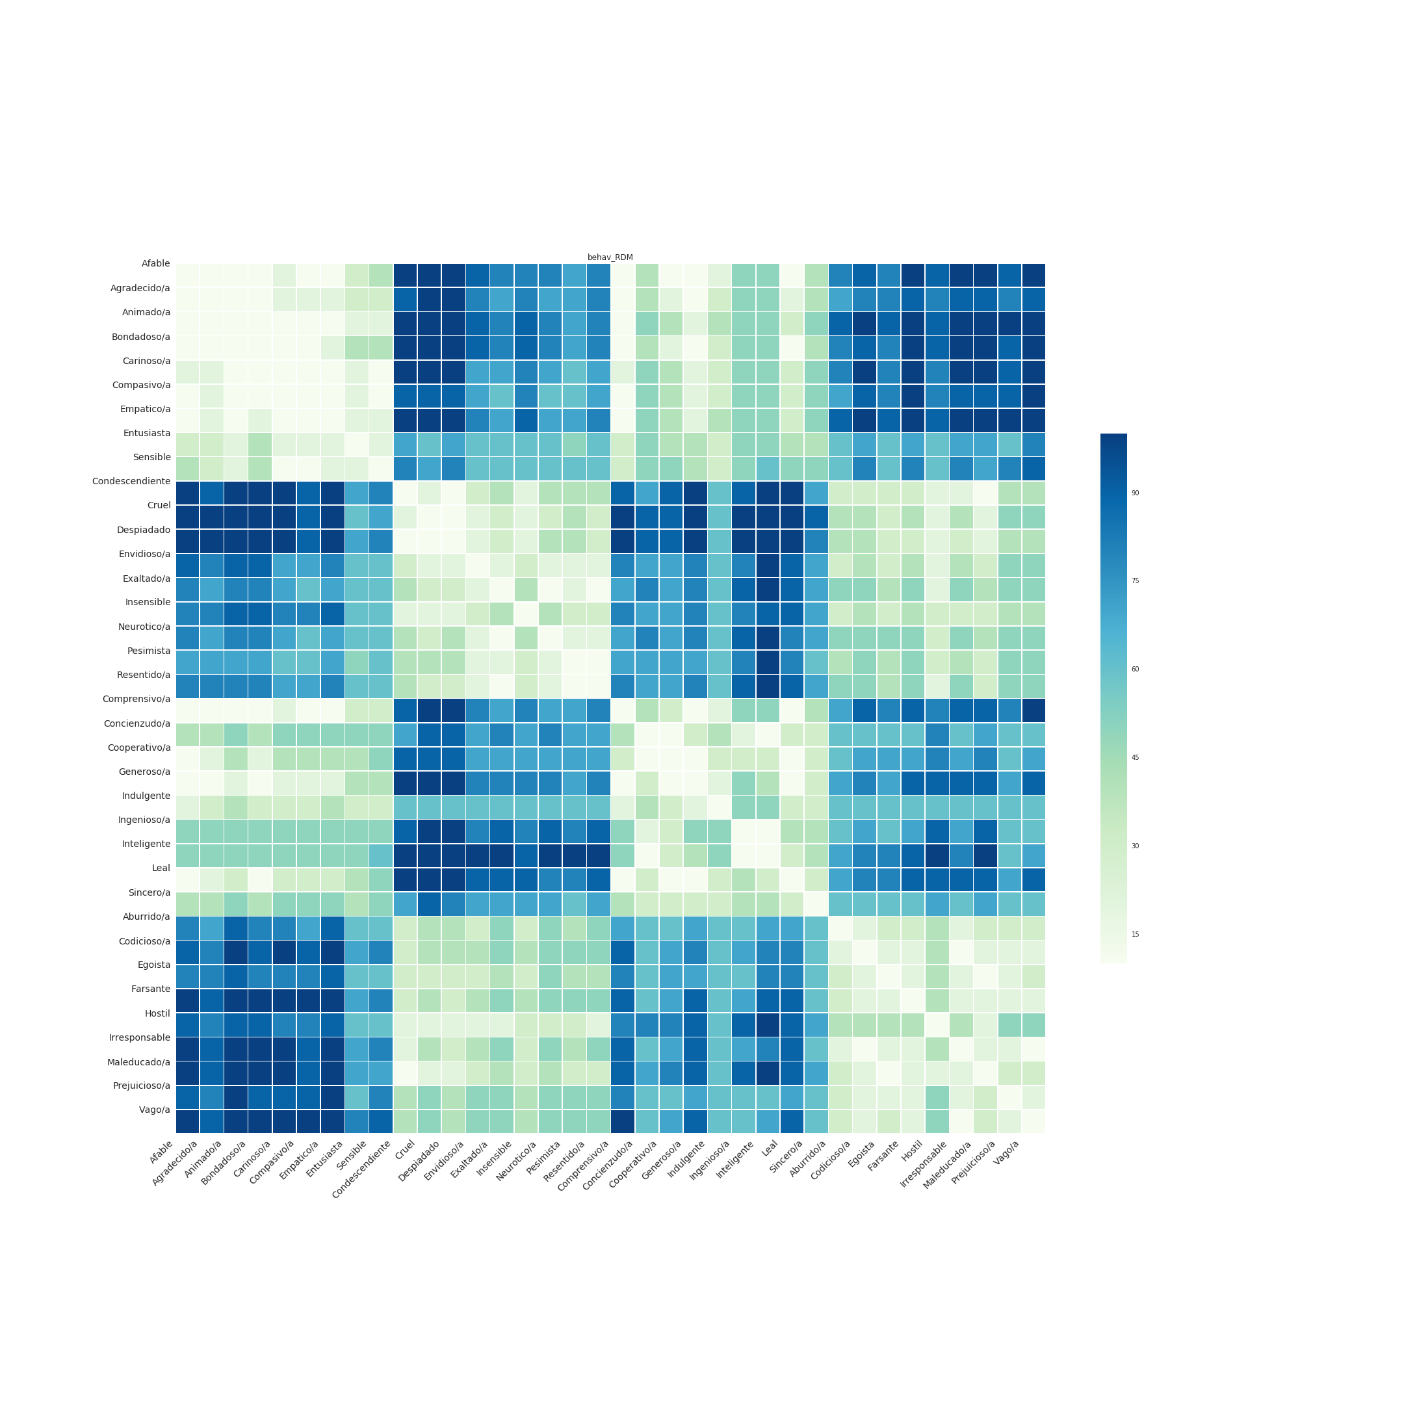
percentile (r)

Slide 15
Decoding analysis:
Can we classify concept category above chance level?

Slide 16
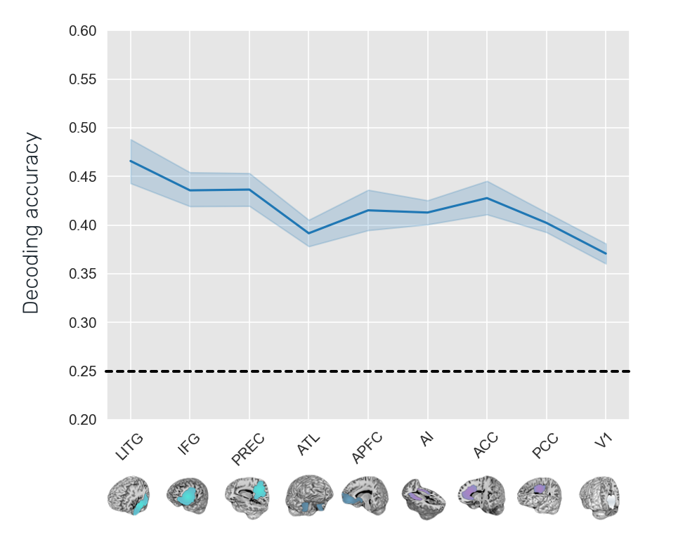
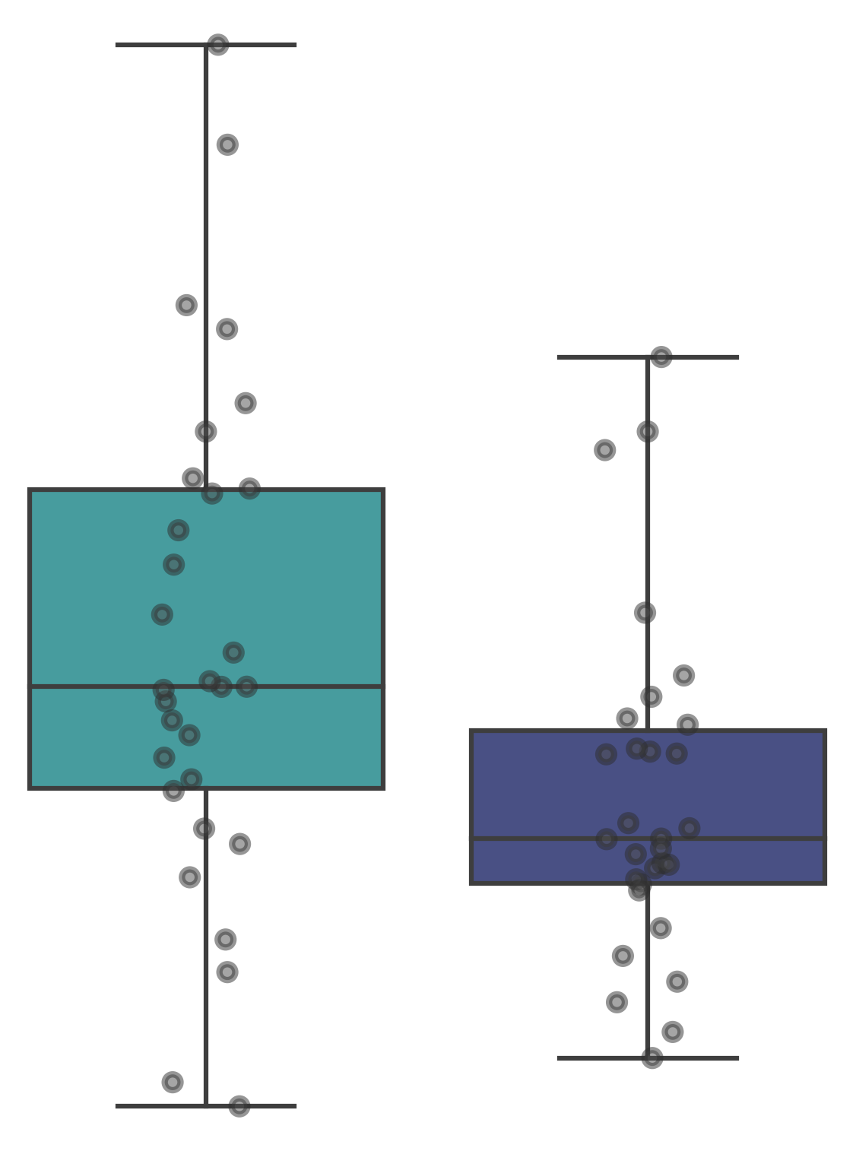
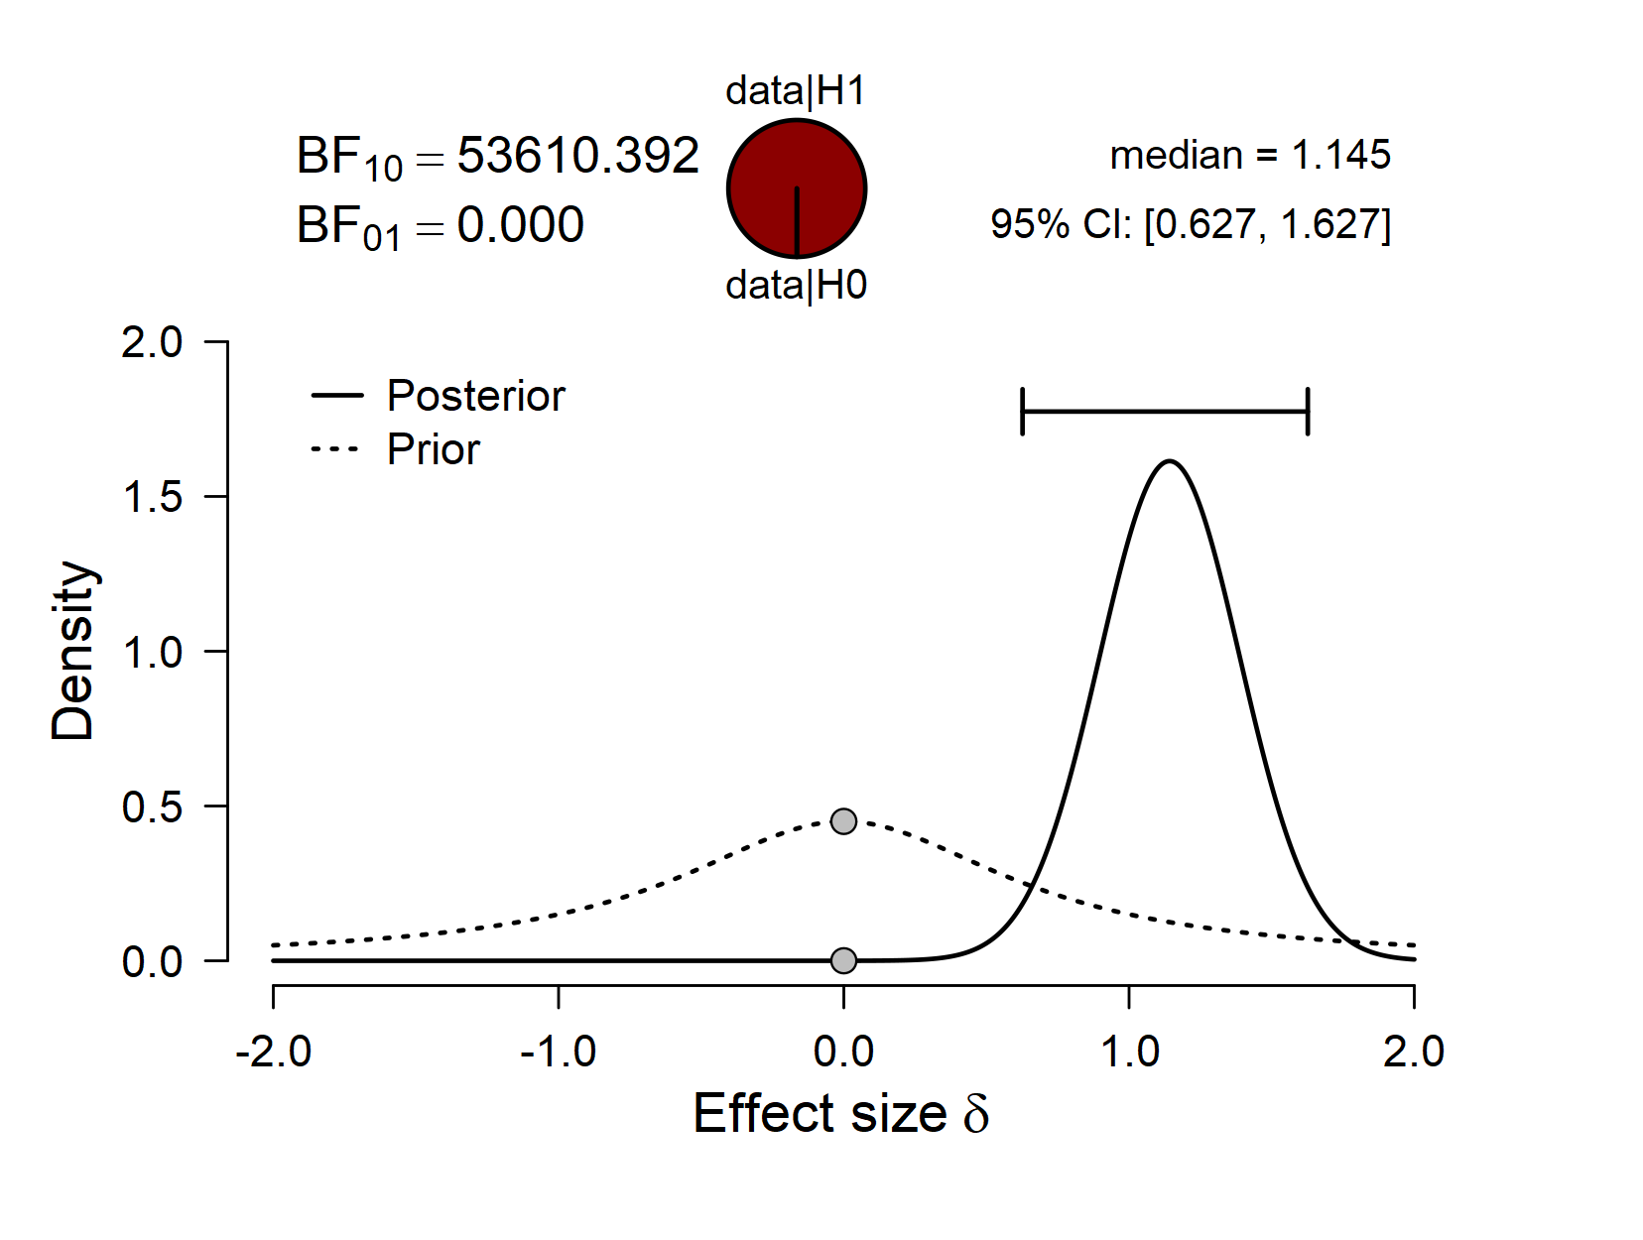
***
***

Slide 17
Decoding analysis:
Are both categories equally informative for the classification?

Slide 18
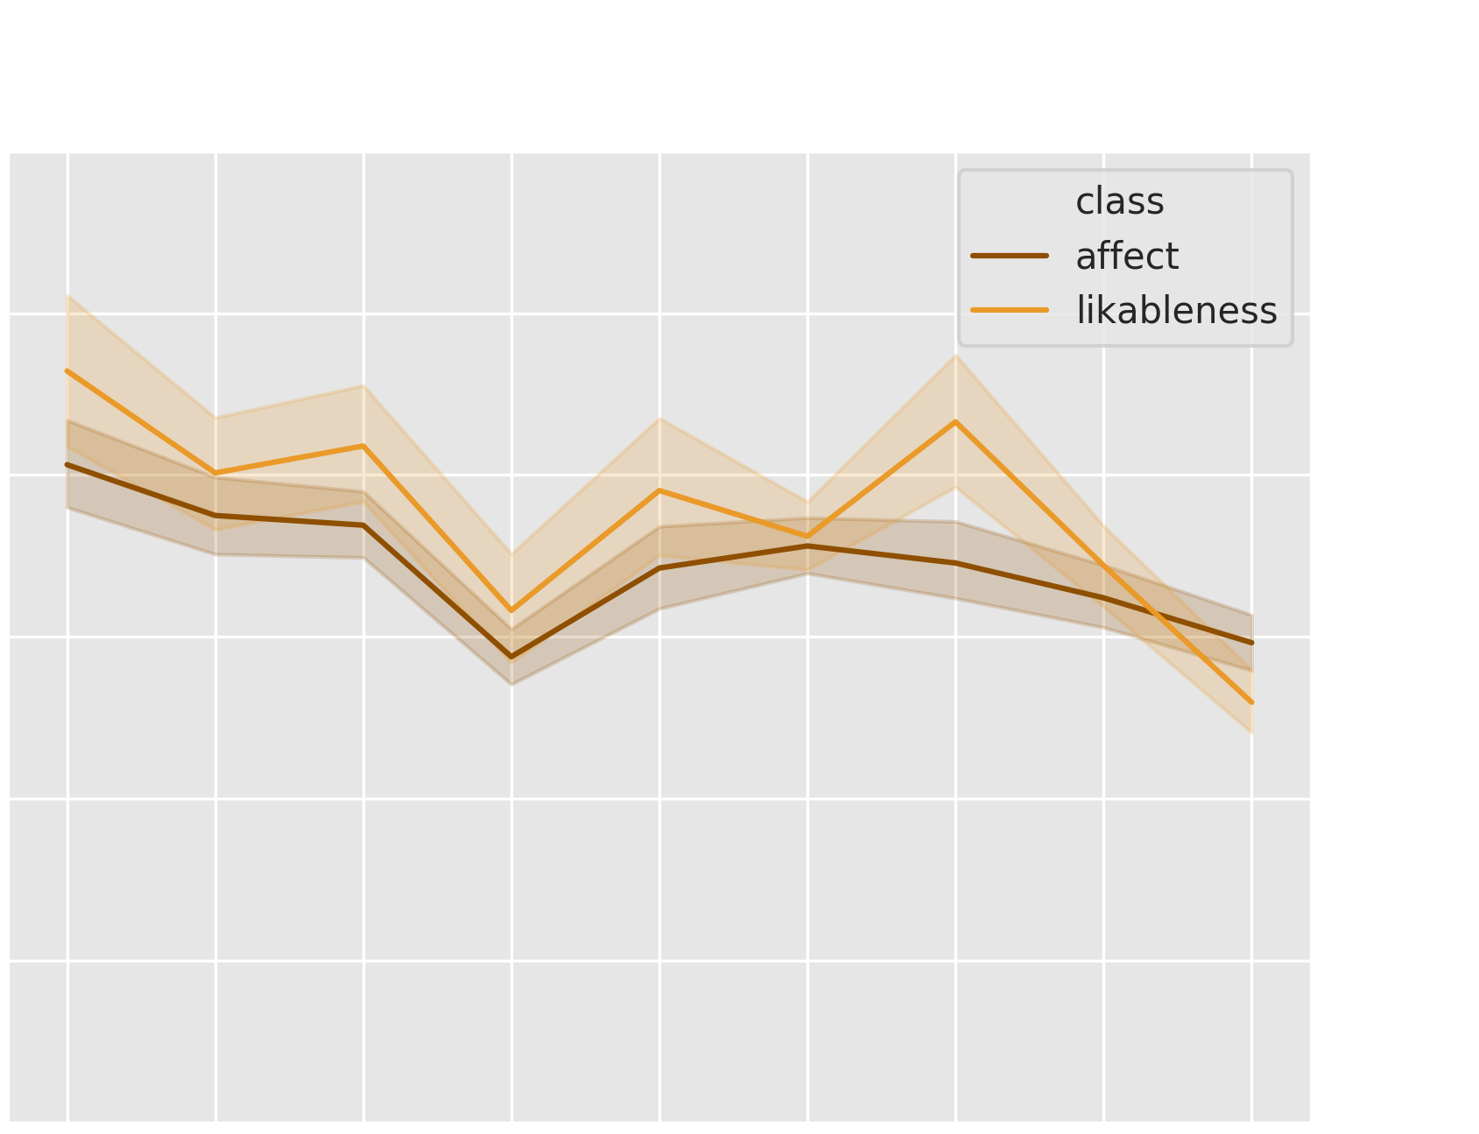
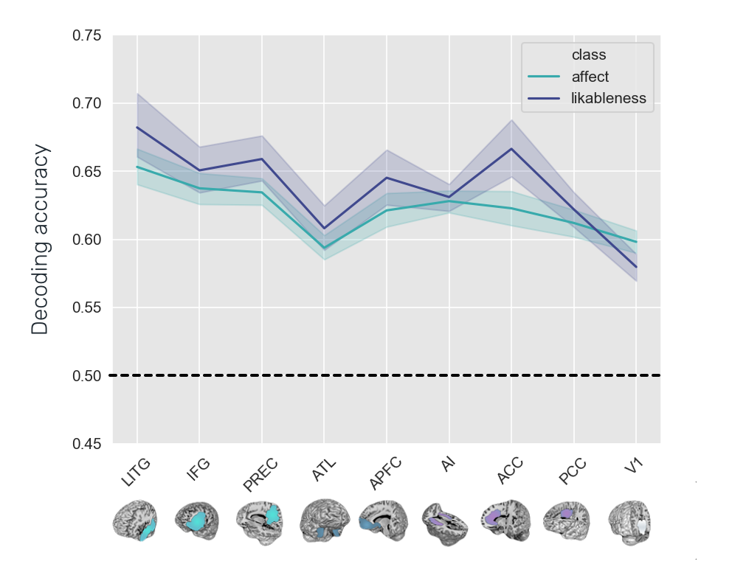
***
 | Sum of Squares | df | Mean Square | F | p | η²
ROI | 0.289 | 4.495 | 0.064 | 39.395 | < .001 | 0.576
CLASS | 0.034 | 1.000 | 0.034 | 7.801 | 0.009 | 0.212
ROI * CLASS | 0.037 | 5.699 | 0.006 | 7.640 | < .001 | 0.209

Slide 19
percentile (r)

Slide 20
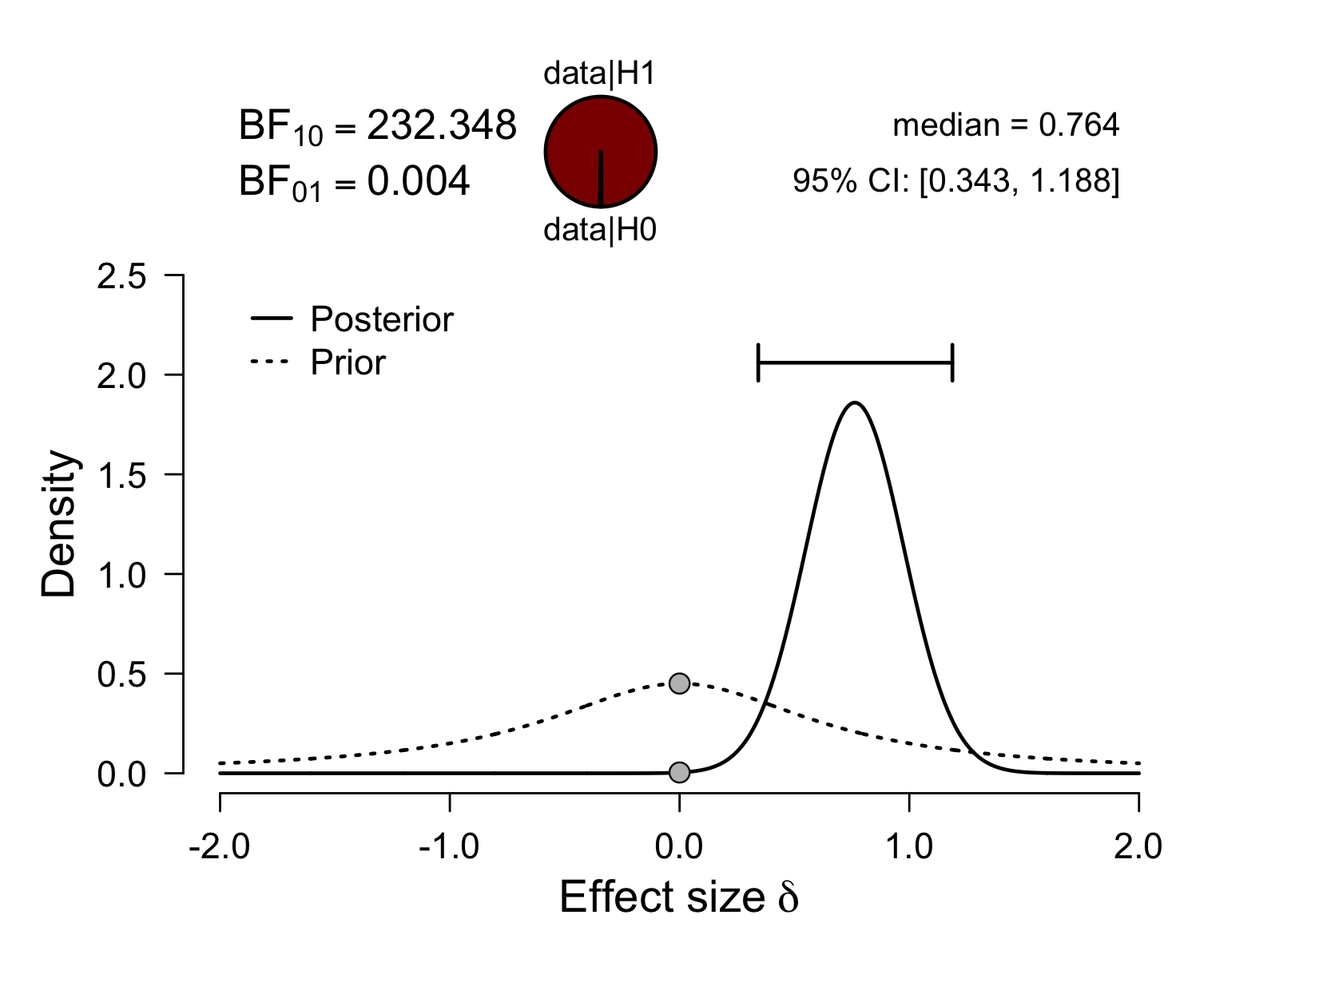
***
 | Sum of Squares | df | Mean Square | F | p | η²
ROI | 0.289 | 4.495 | 0.064 | 39.395 | < .001 | 0.576
CLASS | 0.034 | 1.000 | 0.034 | 7.801 | 0.009 | 0.212
ROI * CLASS | 0.037 | 5.699 | 0.006 | 7.640 | < .001 | 0.209
***

Slide 21
Further exploratory analyses
Encoding model

Slide 22
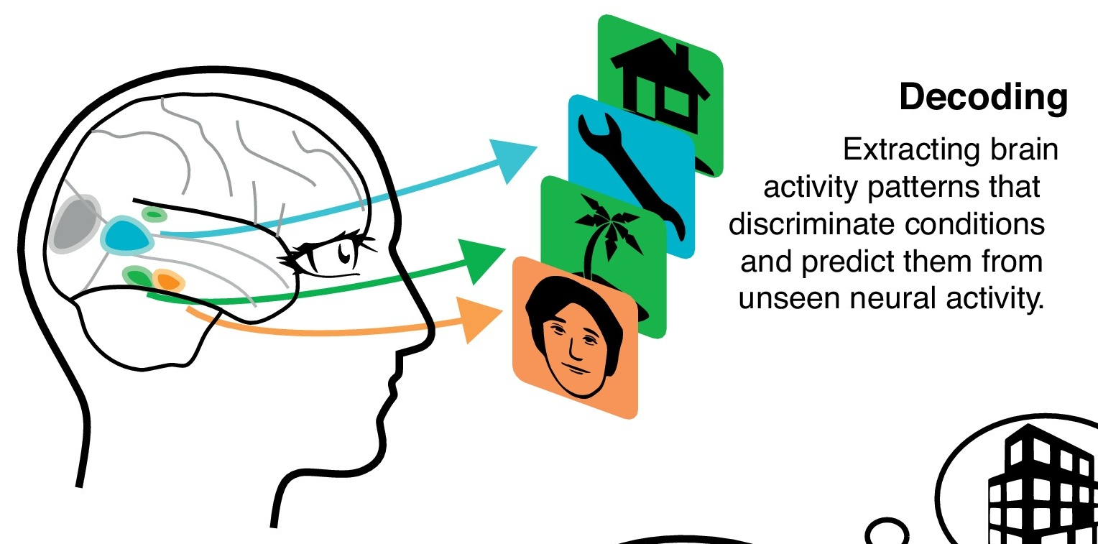
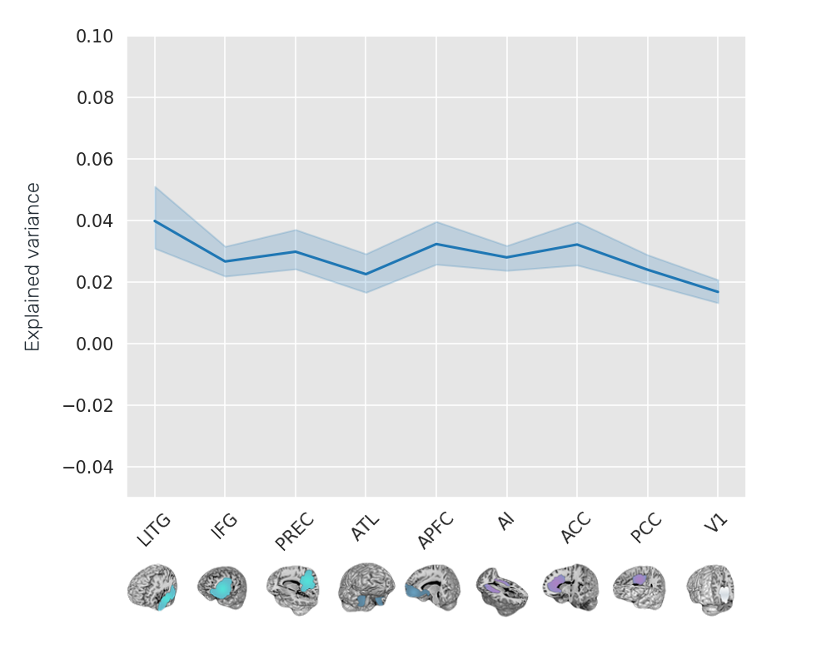
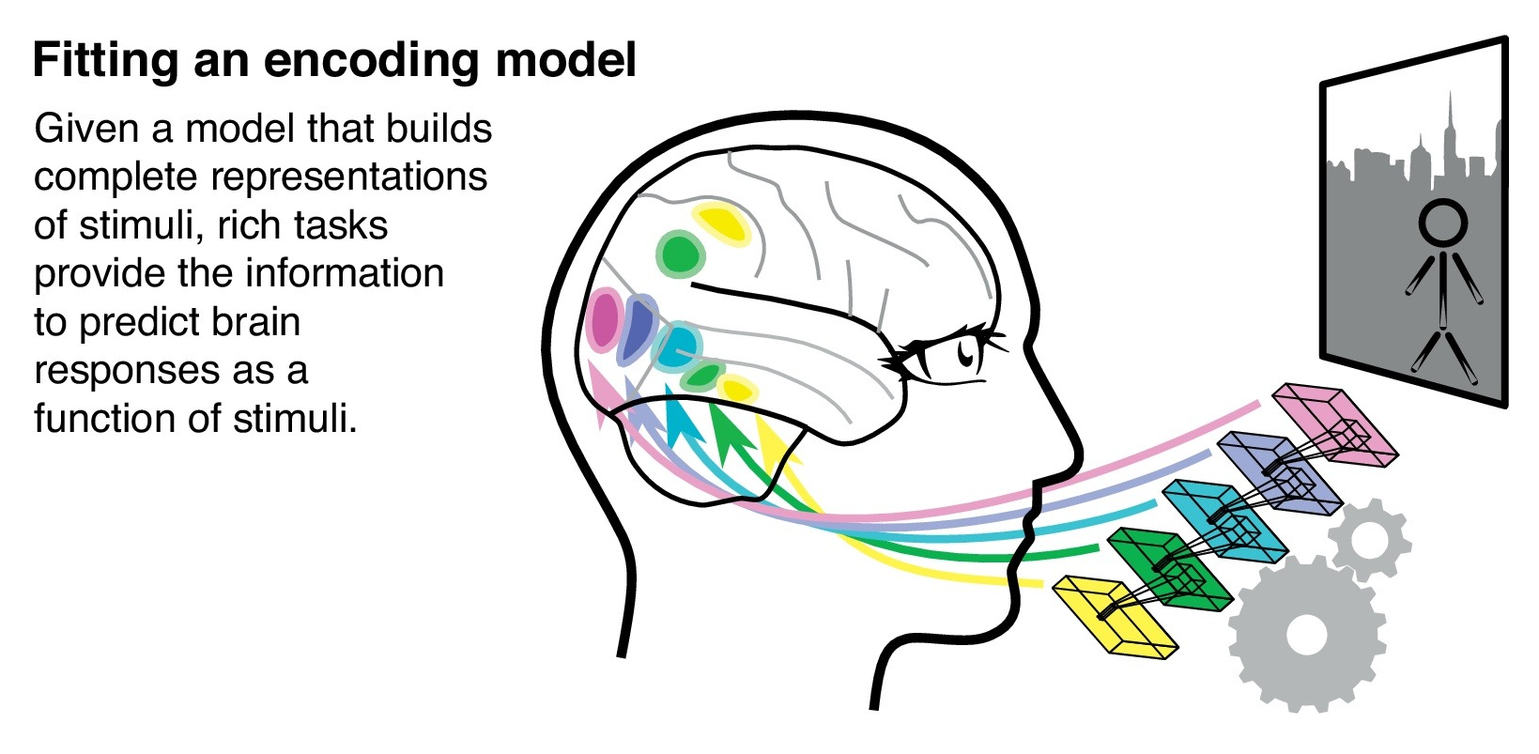
Varoquaux & Poldrack 2019 Curr Opin Neurobiol

Slide 23
Further exploratory analyses
Representational (di)similarity analysis

Slide 24
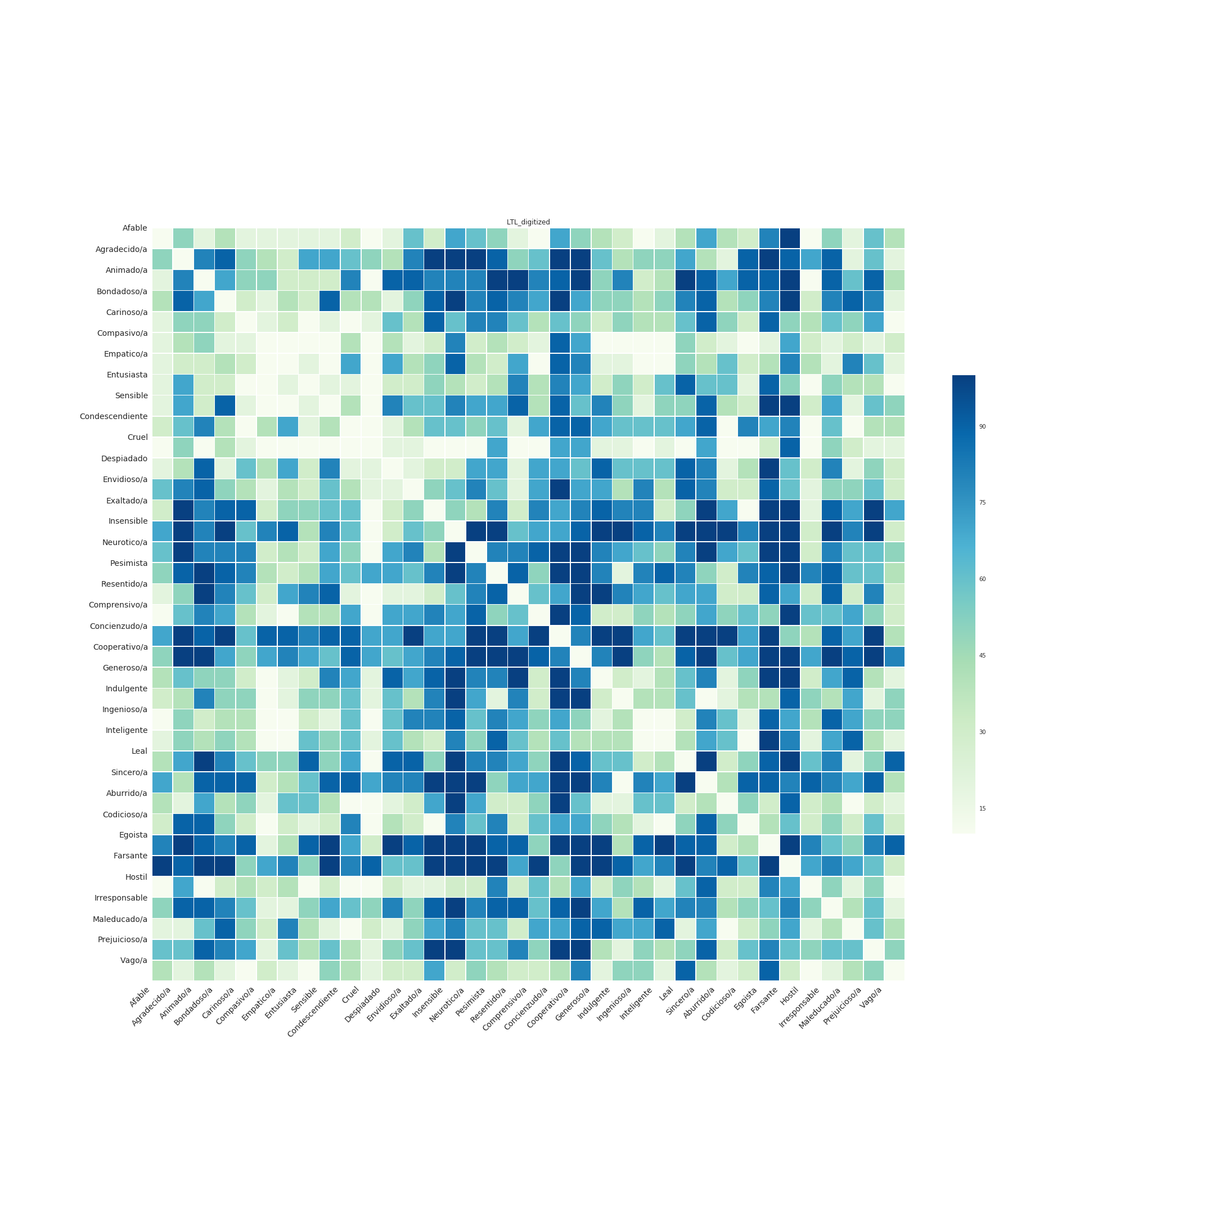
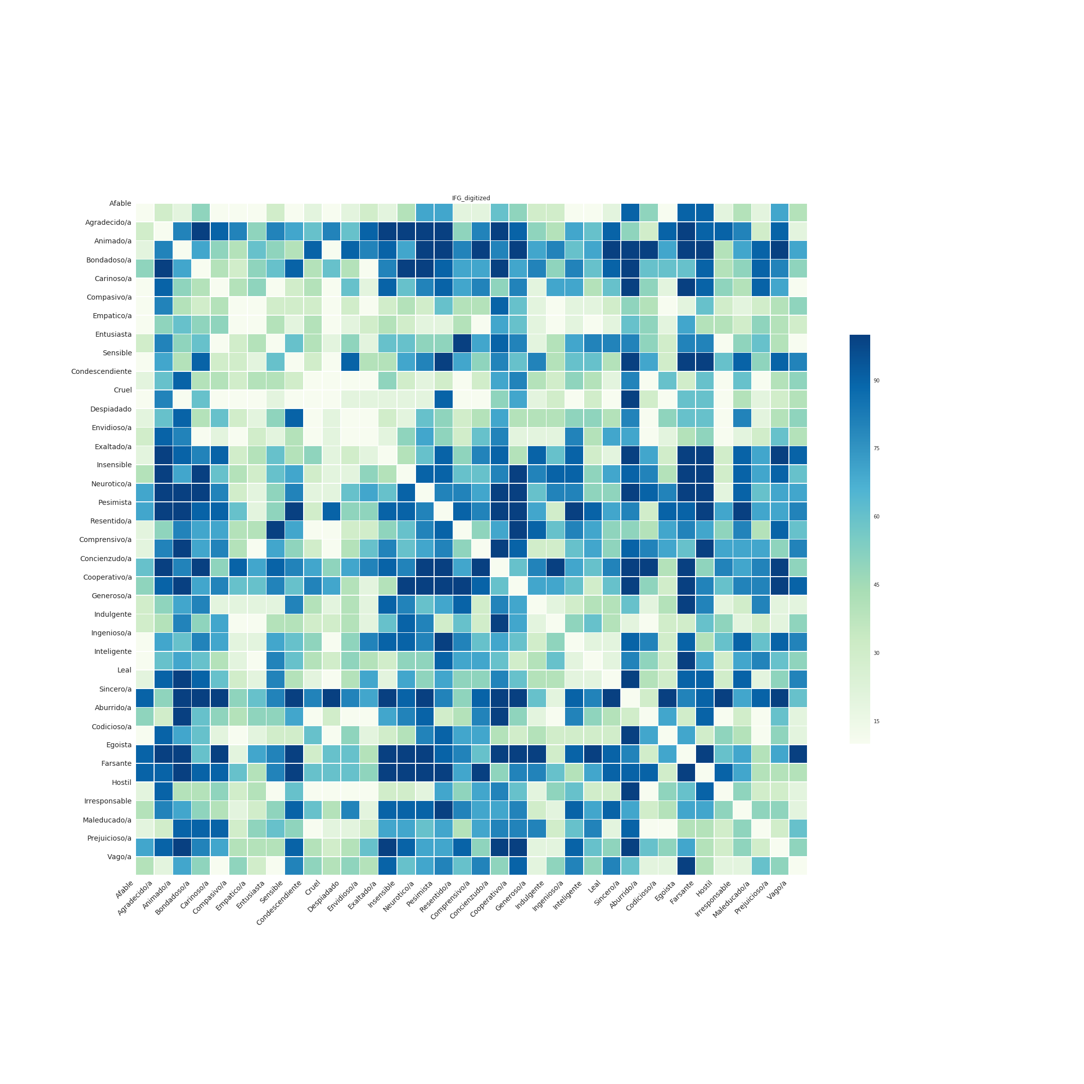
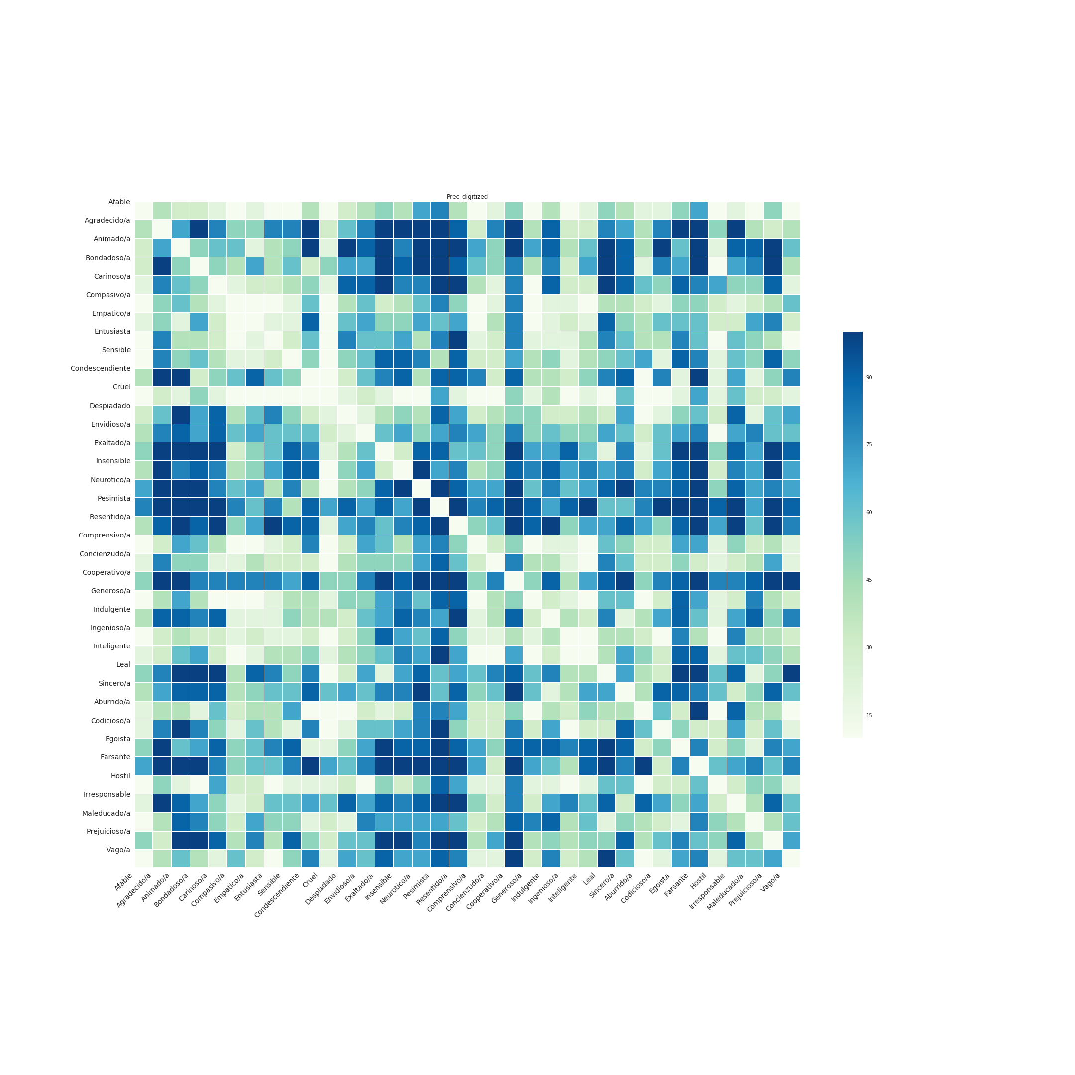
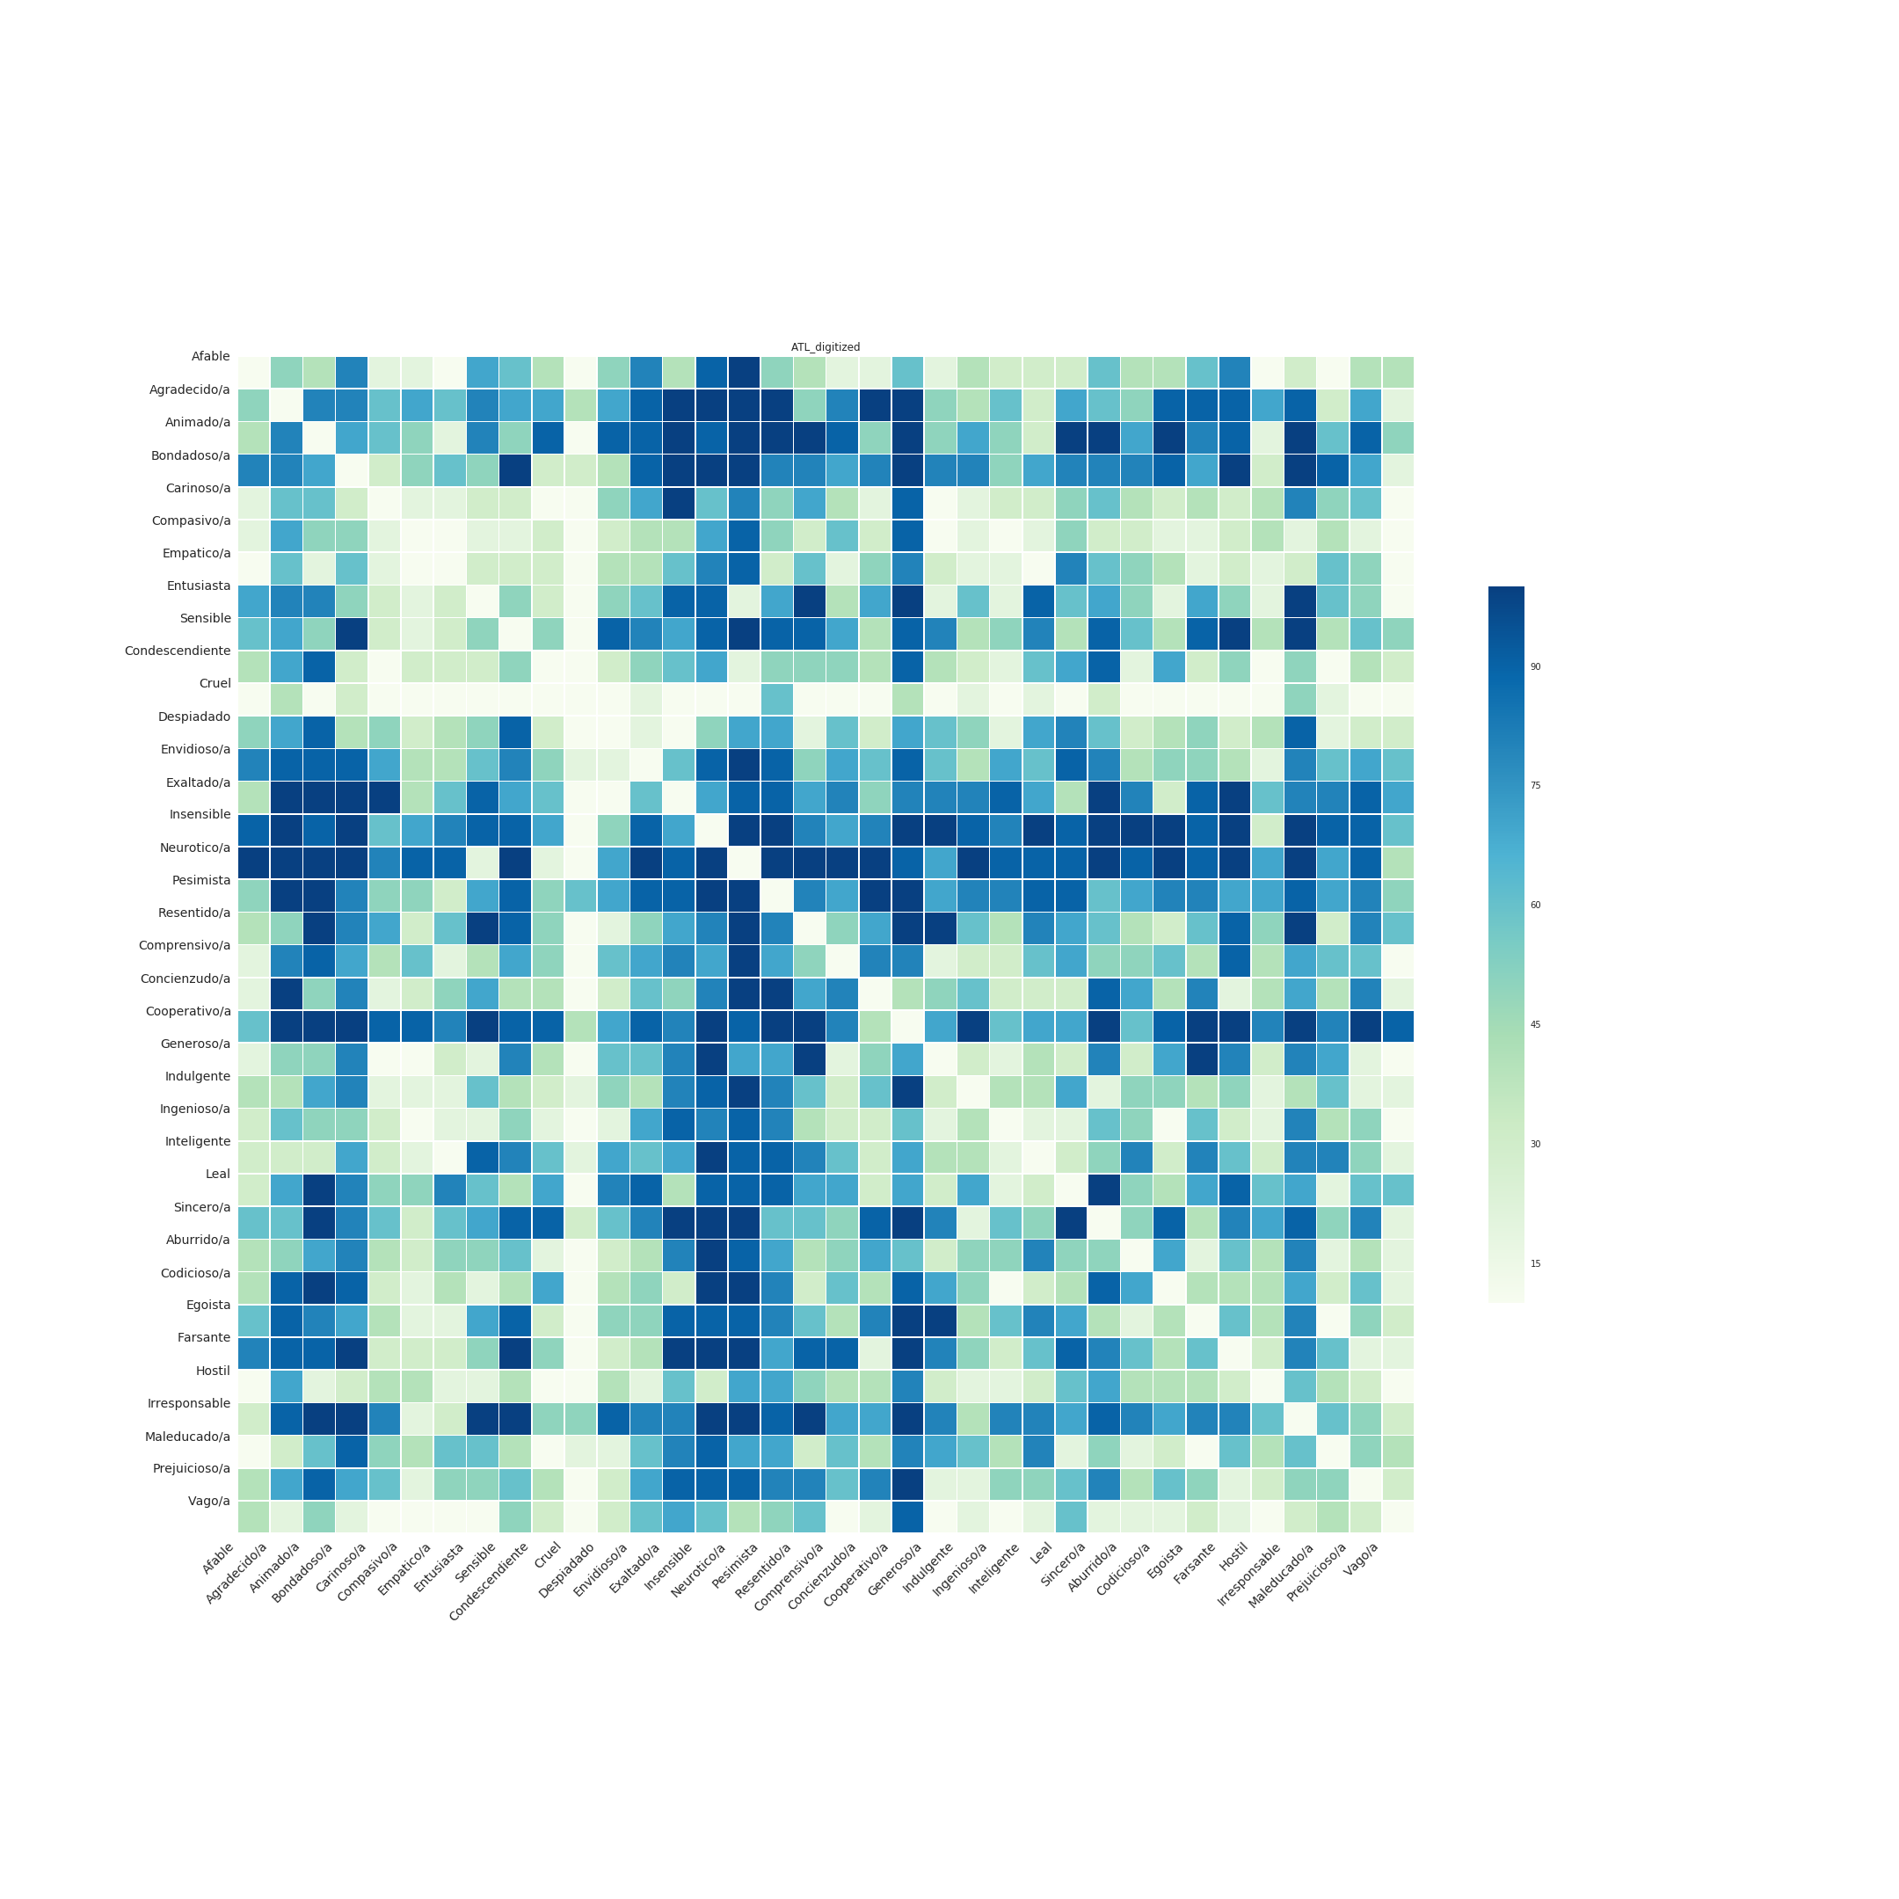
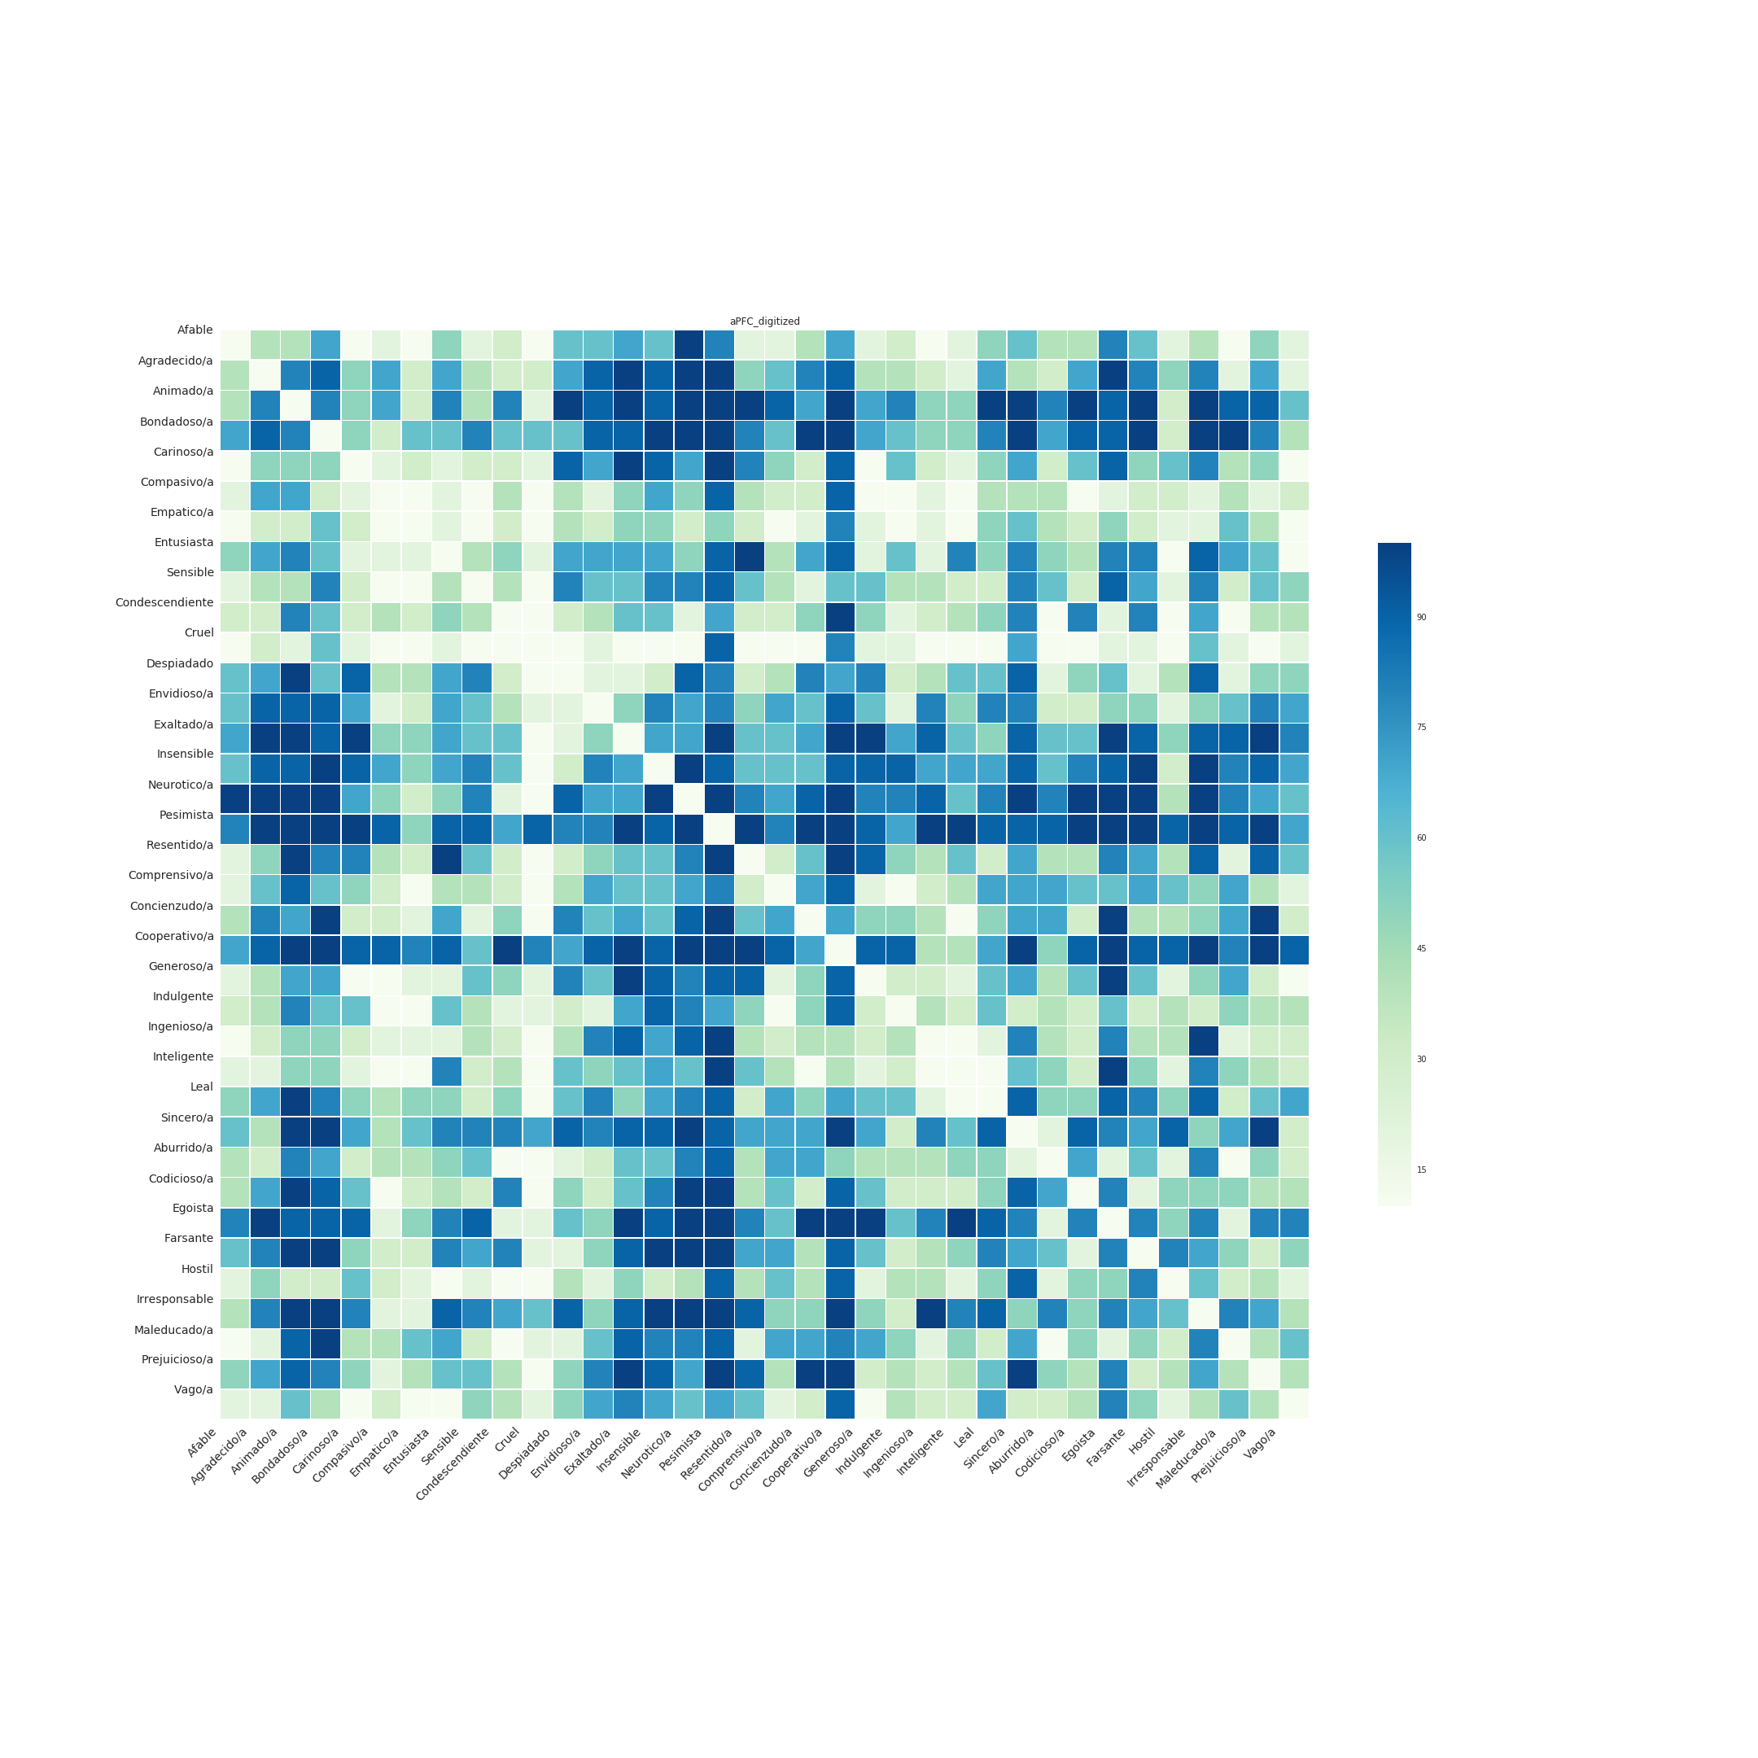
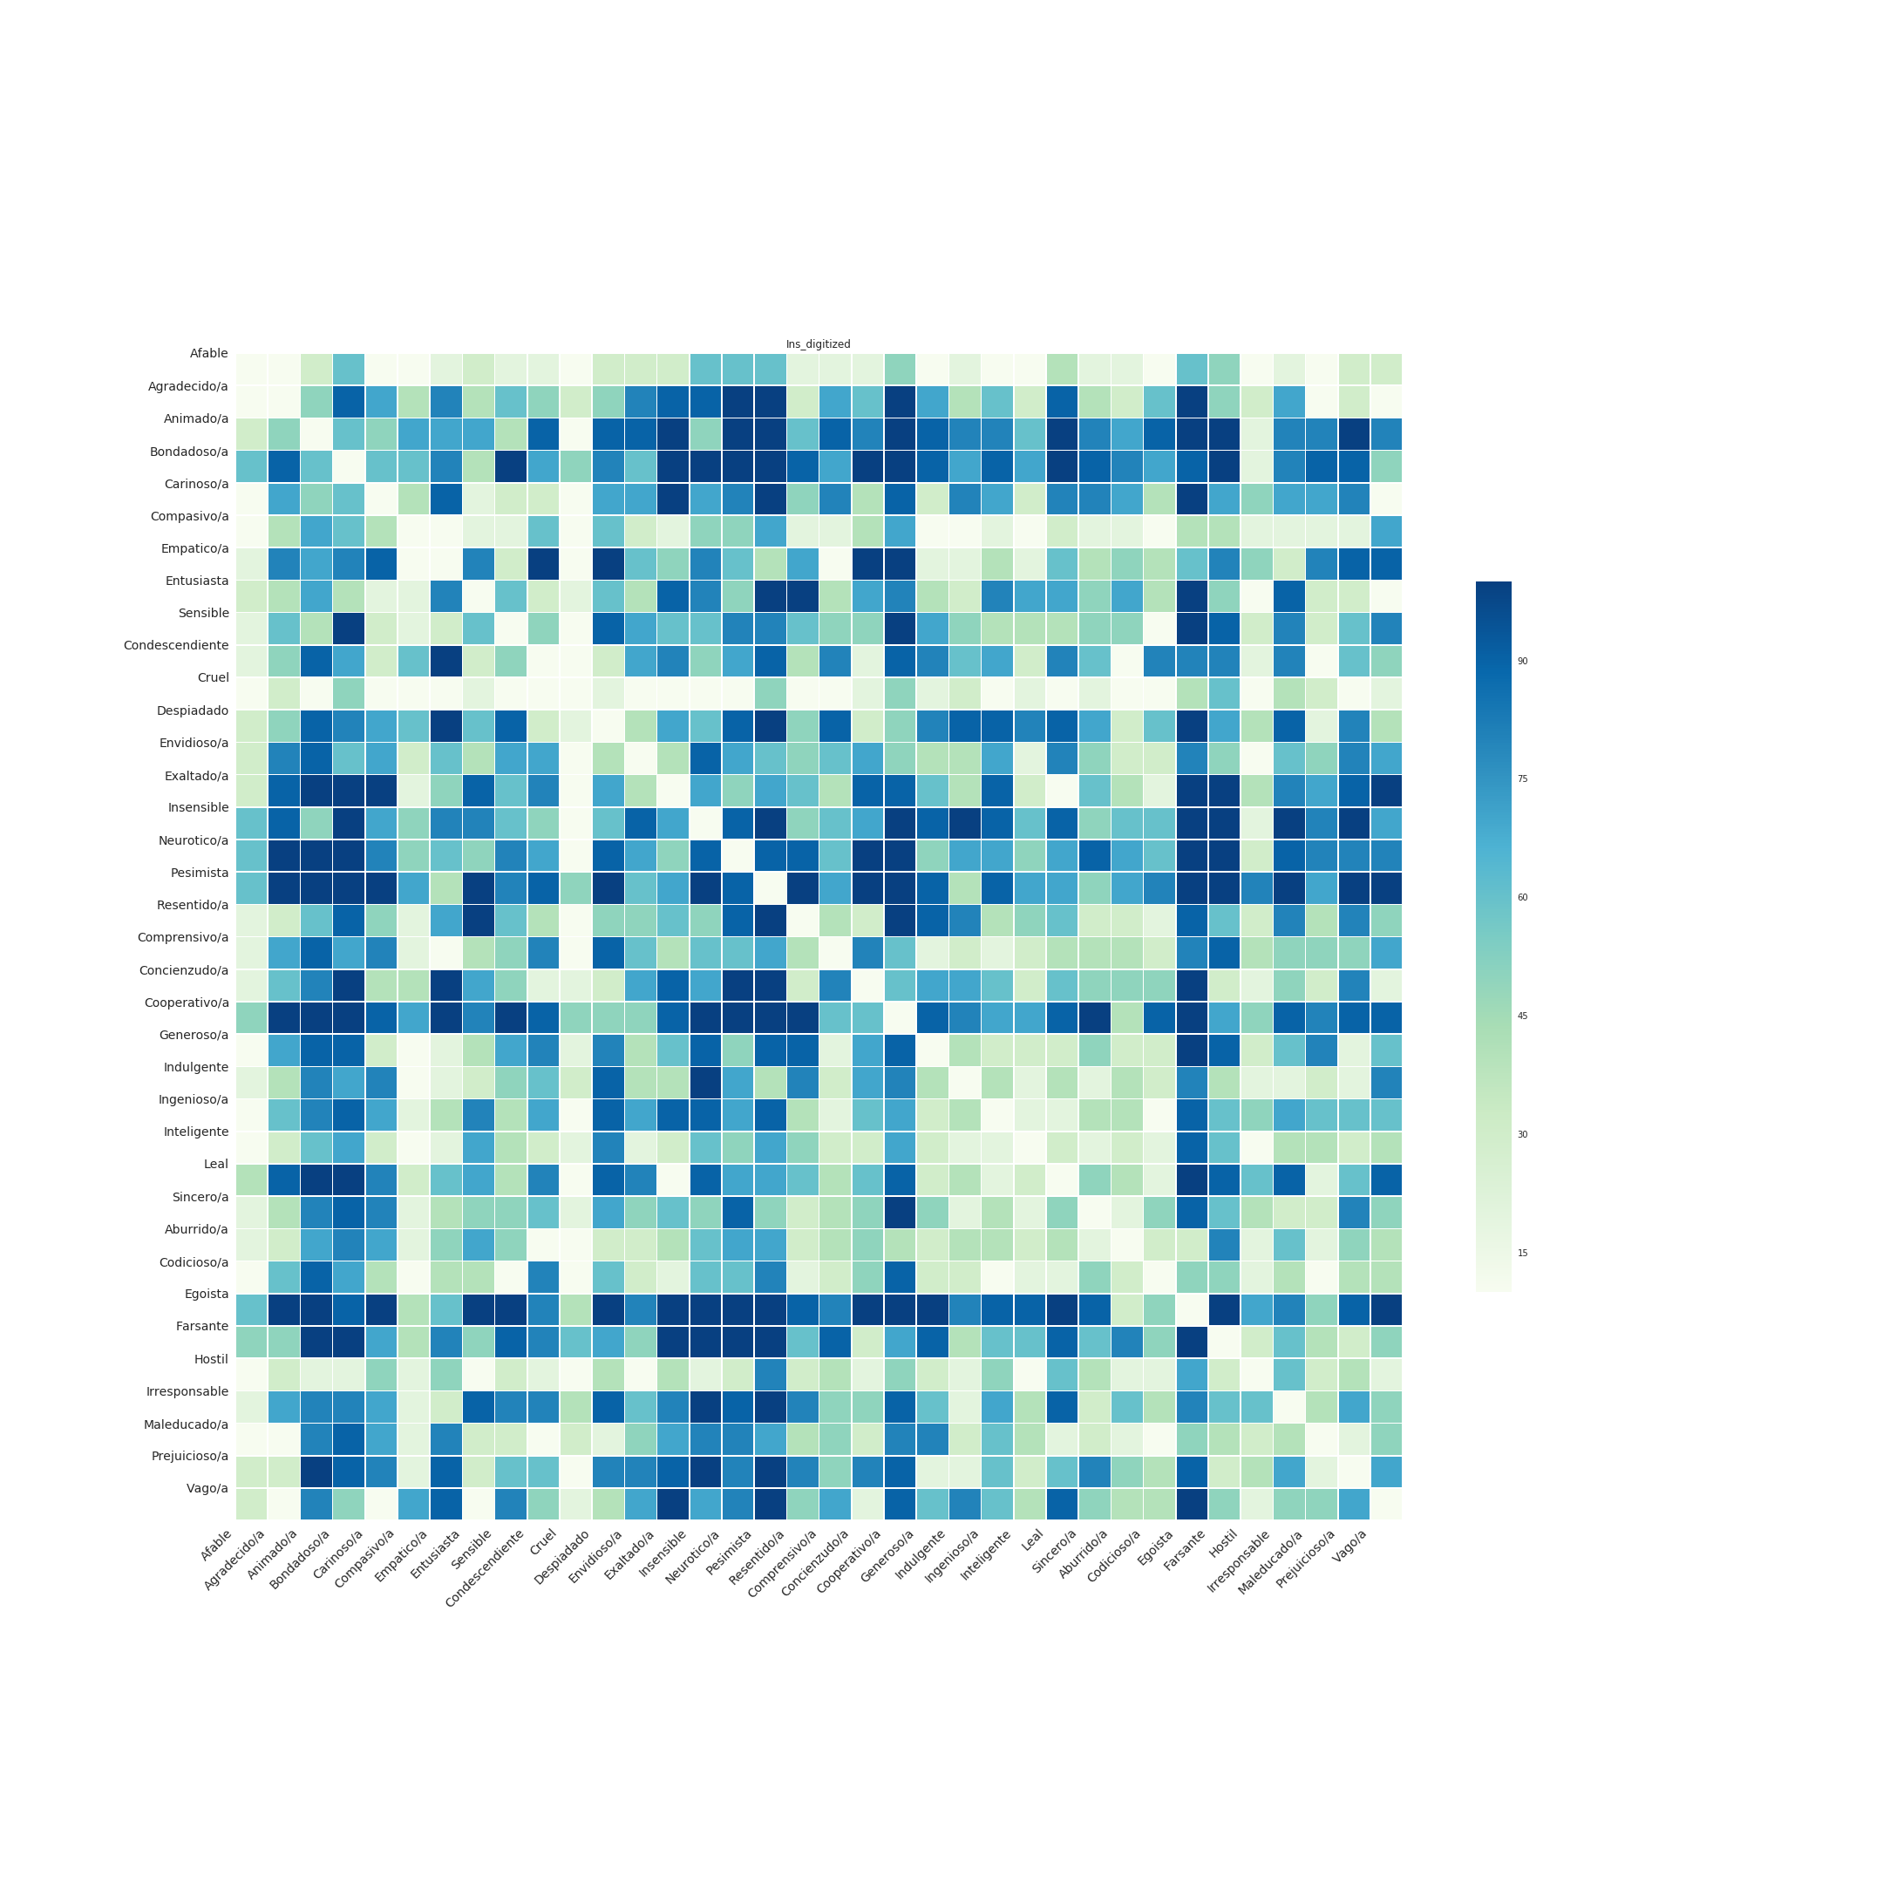
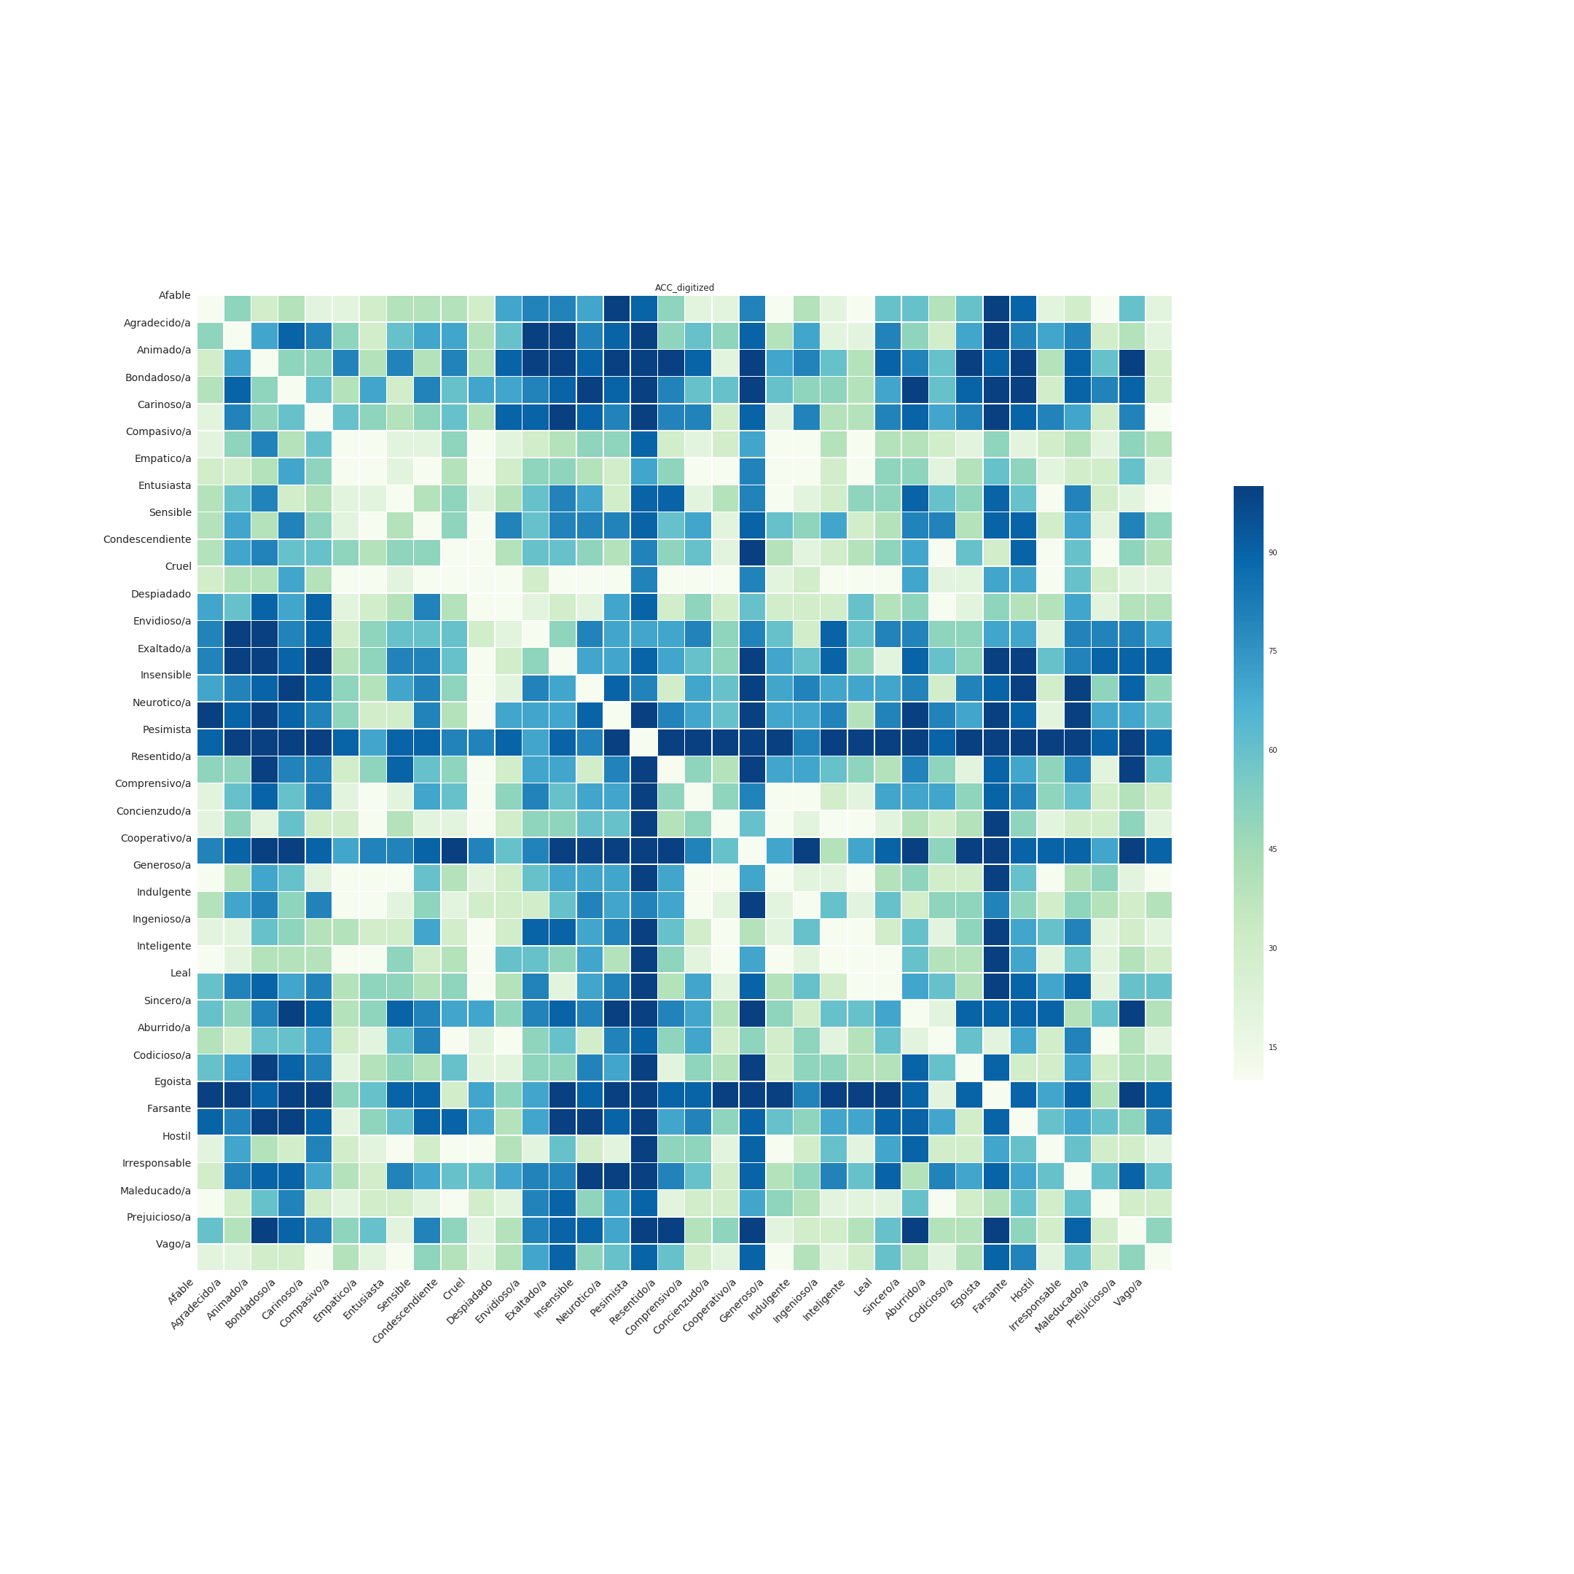
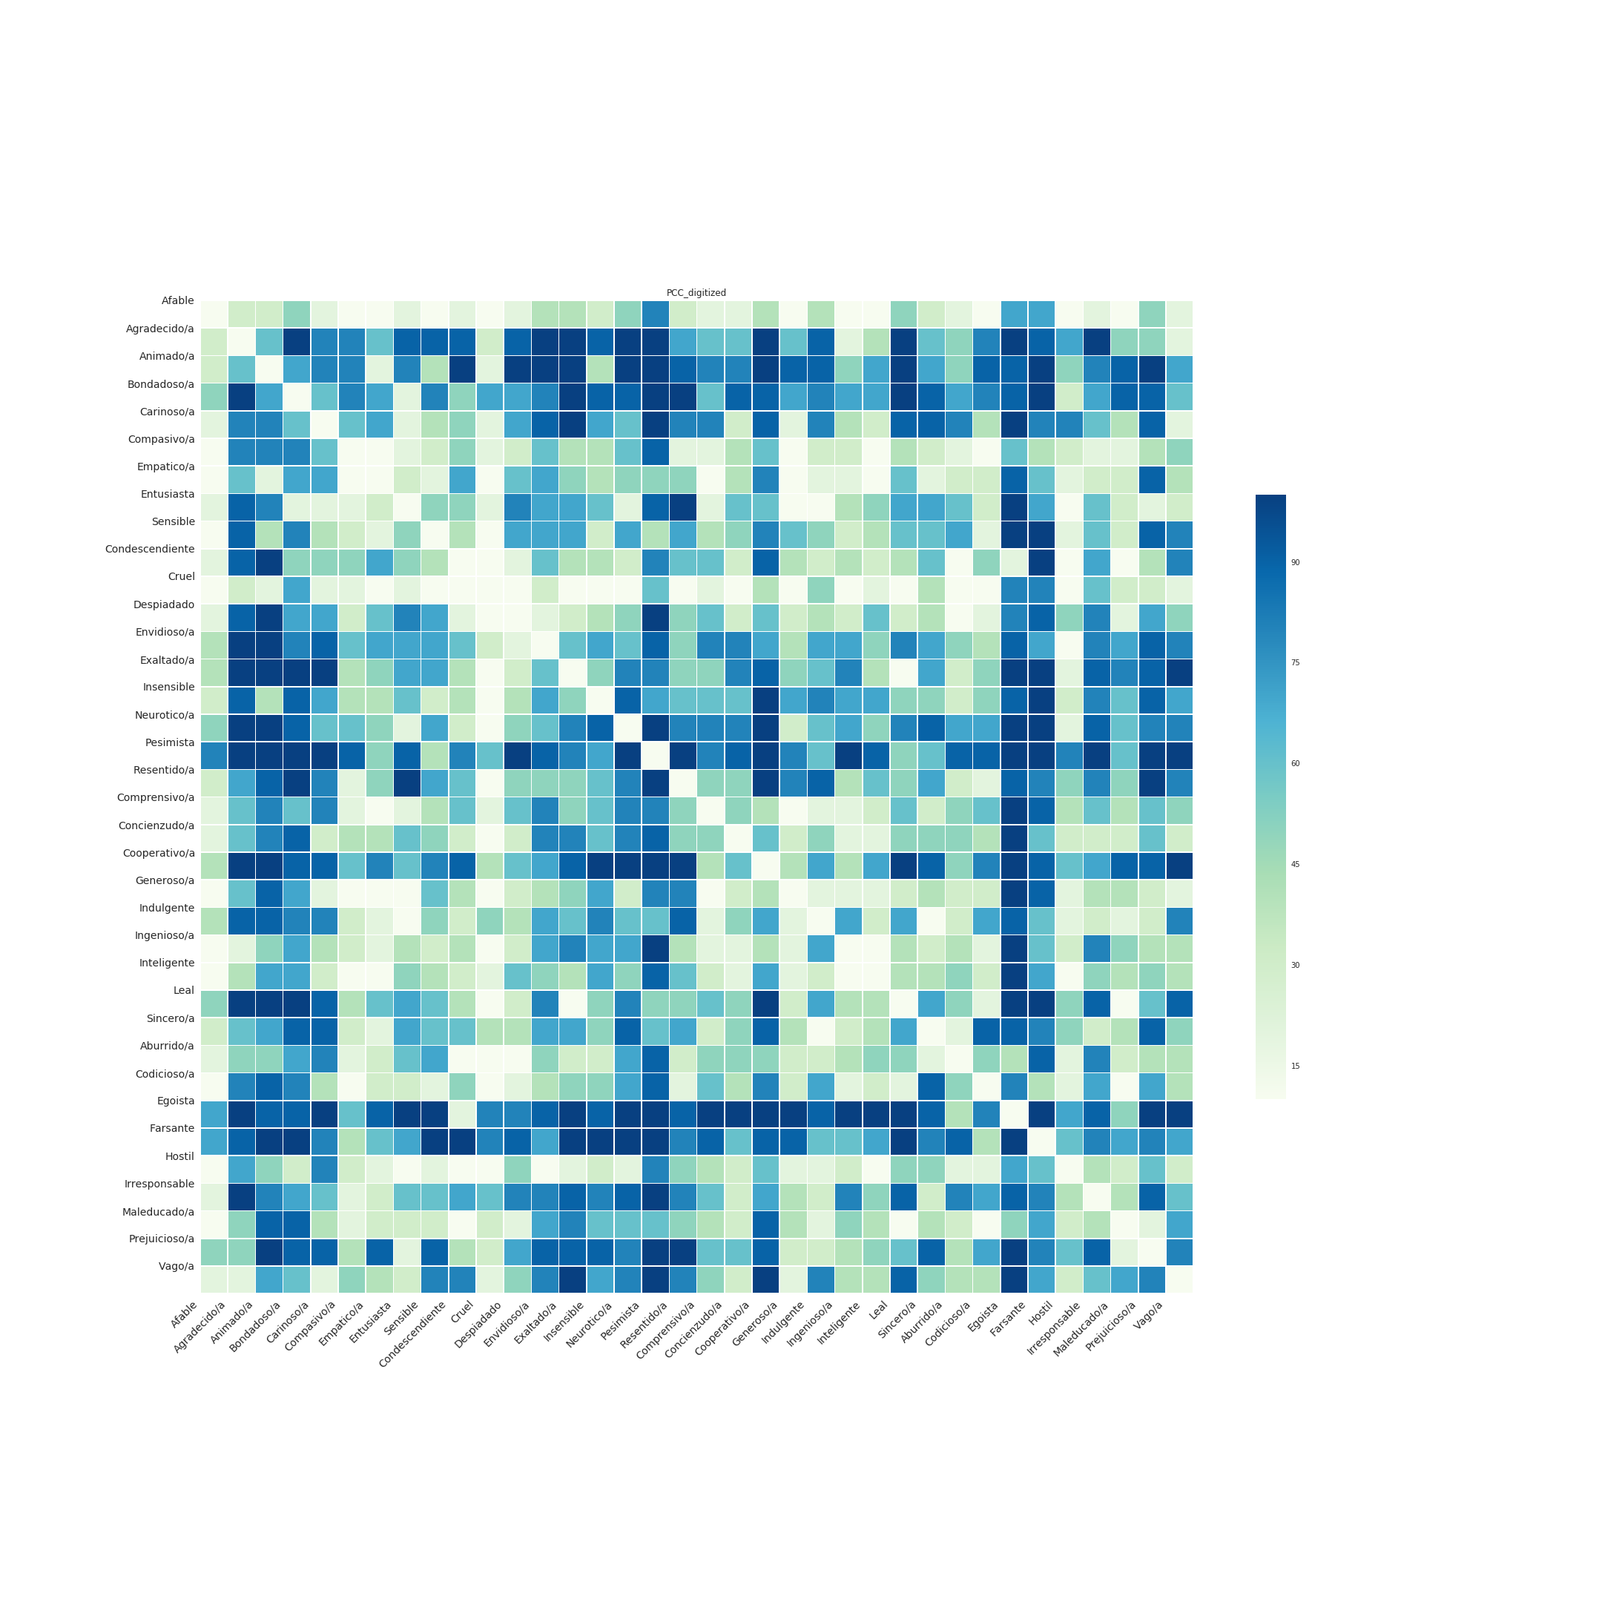
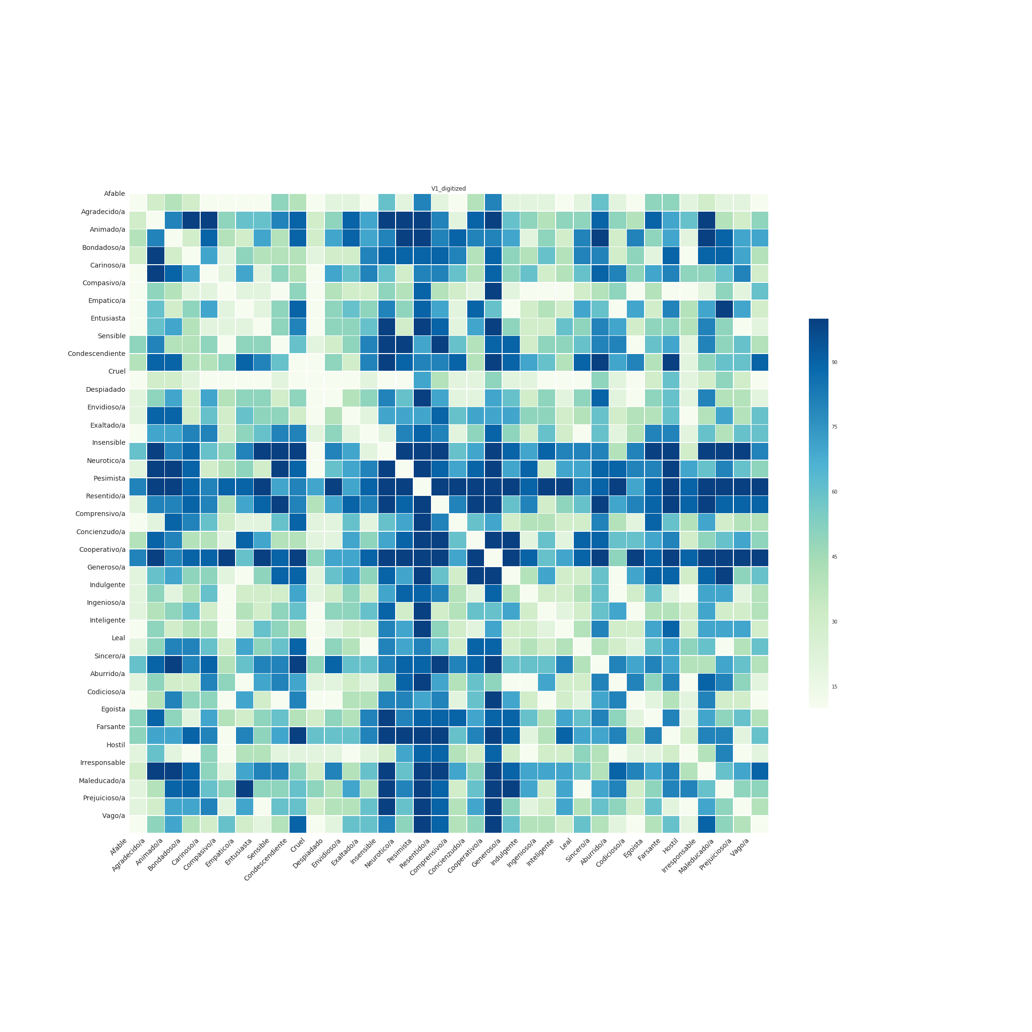
percentile (r)

Slide 25
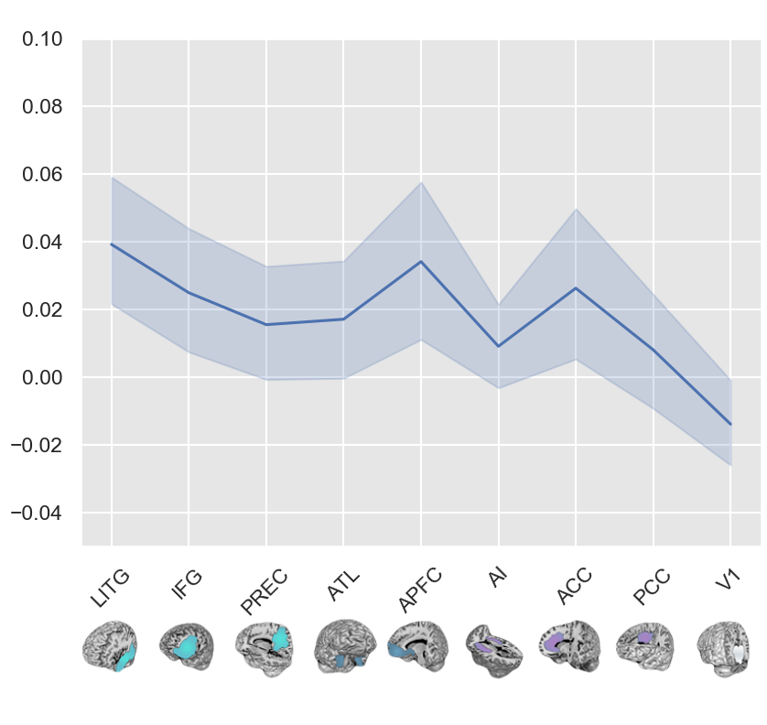
Spearman’s rank correlation (ρ)

Slide 26
Open questions:
Leave-one-concept-out CV
Use a more appropriate control region
Are the ROIs too big?
What about other representational models?

Slide 27
Thank you!

